Slide 1
What started wwi?

Slide 2
Germany, only recently formed as a whole nation from a collection of smaller states and principalities, wanted to become more influential among its European neighbours and wanted to amass a colonial empire.
The Austro-Hungarian Empire was an ancient relic. It consisted of a collection peoples who really had very little in common, and it was subject to intense nationalistic pressures from its Balkan provinces, which wanted to break away. Although Austria-Hungary had some ambition for new territorial acquisitions, its main goal was to survive as an empire.
France wanted to recover Alsace Lorraine, the eastern province that it had lost to Prussia (now part of Germany) as a result of the Franco-Prussian war. Even more than this, the proud nation wished to exact revenge on its Germanic adversaries.

Slide 3
Russia, like the Austro-Hungarian Empire, was boiling over with revolution and the threat of revolution. The czar, Nicholas II, was hoping to keep the Romanov dynasty alive.
Great Britain had no territorial designs in Europe, nor did it have a score to settle with the Germans, but it was deeply concerned with maintaining and exploiting the vast empire that it had built in Africa, India and Asia during the 19th Century. The continuation of this empire required a stable Europe. Insofar as upstart Germany threatened the European status quo, military intervention against that nation might not only be necessary, but desirable.
Great Britain was involved in a naval arms race with Germany beginning in the 1890s. The rapid expansion of the German High Seas Fleet seemed, to the British, to be aimed at them.

Slide 4
More than the other nations, Italy and Turkey watched at waited. They saw nothing to gain from initiating conflict, but they were prepared to enter an ongoing war on whatever side promised the greater reward. Italy saw the prospect of territorial gain. For Turkey, the prize was regaining some of its recently lost lands and much of its vanished prestige.

Slide 5
Sarajevo
In 1908, the Austro-Hungarian Empire annexed Bosnia and Herzegovina from the Ottoman Empire.
The Serbs, neighbours of Bosnia-Herzegovina, saw the region as vital to their nationalist interests; influential officers in the Serbian military created a secret society, called the Black Hand, which trained anti-Austro-Hungarian resistance fighters in Bosnia-Herzegovina.

Slide 6
Into this troubled region, in June 1914, ventured Franz Ferdinand, Archduke of Austria, inspector general of the Austro-Hungarian army and heir to the throne.
Along with his wife, Sophie, Duchess of Hohenberg, he decided to make a state visit to his empires’ most recent acquisition. He saw himself becoming king of the Slavs, as well as Emperor of Austria and King of Hungary.
The archduke and duchess arrived in Sarajevo on June 28, 1914. Along the route of their procession the couple survived the explosion of a small bomb, but when their driver took a wrong turn into a blind alley and backed out, Gavrilo Princip, a Serbian nationalist, found himself alongside the open car and shot both Franz Ferdinand and Sophie.

Slide 7
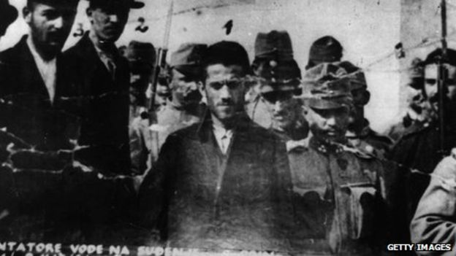

Slide 8
Though the Serbian government didn’t necessarily have anything to do with the assassination, Austria-Hungary blamed them for the attack, hoping to use the incident as justification for settling the problem of Slavic nationalism in the Balkans region.
Although Serbia requested international mediation, A-H refused. It became clear that they didn’t want to only avenge the death of their heir, it wanted to go to war. To attack and defeat Servia would crush the nationalist movement and secure a foothold to the Balkans.
This would trigger a chain of events…

Slide 9
What about The Alliances???
The outbreak of the war was directly triggered by the assassination of the Austrian archduke, Franz Ferdinand and his wife, on 28th June 1914 by Bosnian revolutionary, Gavrilo Princip.
This event was, however, simply the trigger that set off declarations of war. The actual causes of the war are more complicated and are still debated by historians today.

Slide 10
An alliance is an agreement made between two or more countries to give each other help if it is needed. When an alliance is signed, those countries become known as Allies.
A number of alliances had been signed by countries between the years 1879 and 1914. These were important because they meant that some countries had no option but to declare war if one of their allies. declared war first.

Slide 12
Austria-Hungary declared war on Serbia on July 28, 1914, a month after the assassination.
Russia, bound by treaty to Serbia, mobilized its vast army.
Germany viewed the Russian mobilization as an act of war against its ally Austria-Hungary and so declared war on Russia.
France, bound by treaty to Russia, declared war on Germany and, by extension, its ally Austria-Hungary.
Great Britain was more loosely bound to France by an understanding of cooperative action, which didn’t oblige them to join. But Britain’s sympathies clearly lay with the French and against the Germans, who presented a competitive threat to Britain’s colonial empire. As they had a treaty with Belgium, when Germany invaded Belgium, it caused Great Britain to declare war on Germany(thus dragging in the British Empire-including Canada, Australia, New Zealand, India…)
For now, Italy and the United States remained neutral. Italy would enter on the German side in 1916. The US joins the British side in 1917.

Slide 13
For the most part, the people of Europe greeted the outbreak of war with jubilation.
The great majority of people—within government and without—assumed that their country would be victorious within months, and could not envision the possibility of a longer conflict.
By the end of 1914, however, well over a million soldiers of various nationalities had been killed on the battlefields of Europe, and there was no final victory in sight for either the Allies or the Central Powers.

Slide 14
The Alliance System
  An alliance is an agreement between one or more states to work together.
    Alliances usually involve making promises to protect the other country against nations who are not in the alliance.
  Designed to keep peace in Europe, instead pushed continent towards war
  Many Alliances made in secret

Slide 15
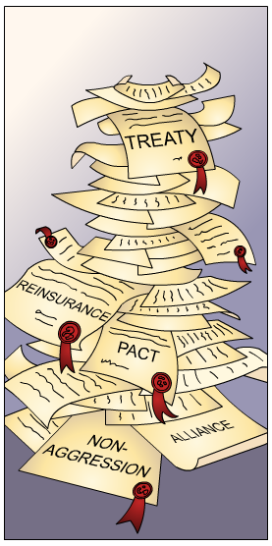
Why were Alliances made?
The aim of forming alliances was to achieve collective security – having alliances with other powerful countries deterred your enemies from attacking you.
If a country started a war with one nation it would have to fight all its allies as well.
Alliances were often made in reaction to national rivalries – when one country felt threatened by another, it often looked to secure friendships with other nations.
By 1900, Europe was full of national rivalries.

Slide 16
By 1907 two major alliances:
  Triple Alliance and Triple Entente

Slide 17
Who is on whose side???
Triple Entente
Triple Alliance
France
Russia
Great Britain (and empire)
United States
Germany
Austria-Hungary
Italy
Turkey

Slide 18
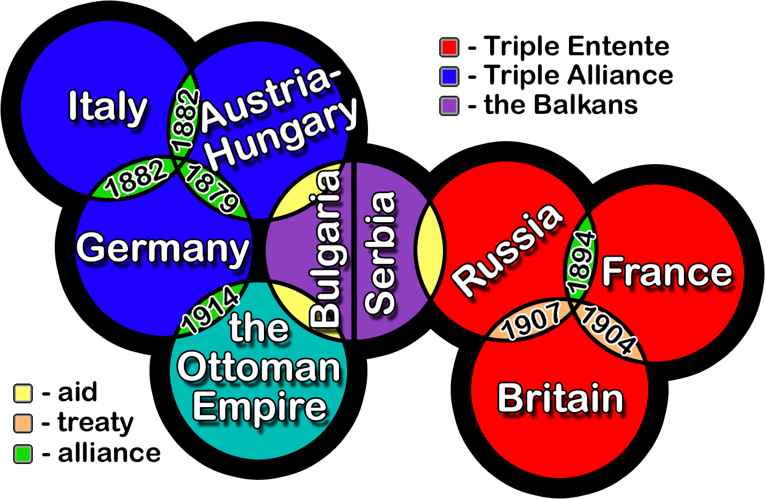

Slide 19
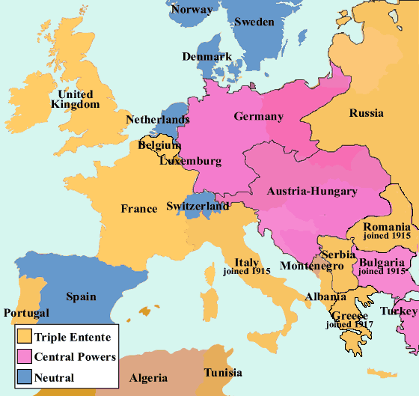

Slide 20
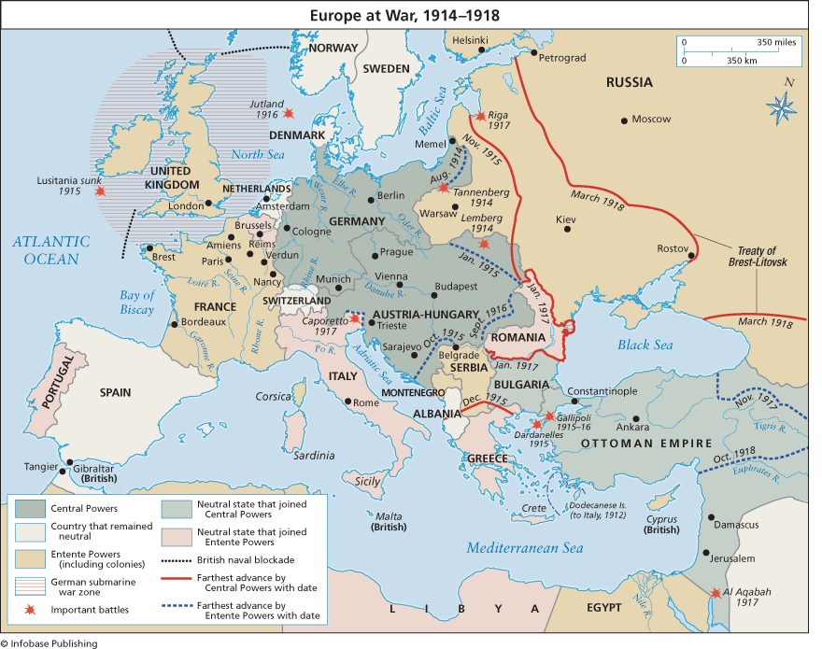

Slide 21
Austria-Hungary: divided state, divided army
In Charge: General Conrad von Hötzendorf-the man who had been keen to crush Serbia after Archduke Franz Ferdinand was assassinated.
Major Strengths: The army was perfectly competent but it was short of men and hampered by some serious weaknesses.
Major Weaknesses: The Austro-Hungarians couldn’t be sure how many fronts they’d need to fight on aside from Serbia in the south and Russia in the east; they worried that they might have to fight the Italians and the Romanians too. The second problem was that their army included Germans, Hungarians, Czechs, Poles, Italians, Slovenes, Bosniaks, Croats, etc some of whom hated each other and couldn’t be trusted to cooperate. Some national groups would be fighting against their own countrymen in the enemy armies. Commanders had to work out which troops they could safely place next to which, and opposite which enemies.

Slide 22
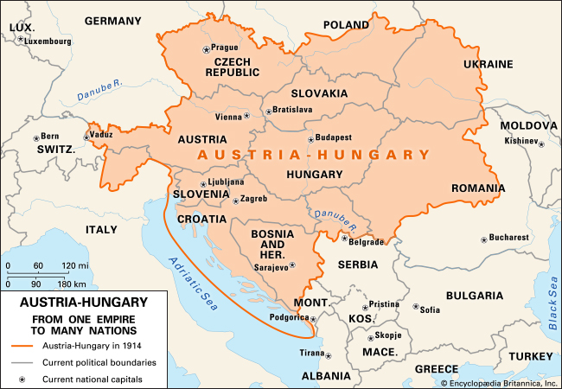

Slide 23
France: The state wary of its own army
In Charge: General Joseph Joffre-a capable leader, shrewd and calm
Major Strengths: The French had a very good 75mm field gun that could do a lot of damage when they deployed it properly. They also had some strong forts along the frontier with Germany.
Major Weaknesses: They didn’t have enough heavy artillery to back up their field gun. They also depended too heavily on those fortresses, which were going to prove deathtraps-for the men inside them.

Slide 24
Germany: The military state
In Charge: Chief of the General Staff Helmuth von Molkte-an intelligent man, good grasp of modern warfare, but a worrier. Soon replaced by Erich von Falkenhayn.
Major Strengths: The German army was well-equipped with machine guns (howitzers-short nozzled artillery guns that could lob shells high in the air) and spades for digging in. The German railway system had lines leading from east to west so the Germans could easily transfer troops from one front to the other.
Major Weaknesses: The Germans had long thought that a war on two fronts would be a disaster for Germany; they were right.

Slide 25
Great Britain: Professional, but small
In Charge: The commander of the British Expeditionary Force was Sir John French, who had made a name for himself during the Boer War.
Major Strengths: The BEF was highly professional. It was expert at using the terrain, and had expert marksmen and highly trained troops. Troops from the British territories proved some of the toughest troops the Germans encountered.
Major Weaknesses: The BEF was small. German generals joked that if the British army every landed in Germany, they would send the local police force to arrest it. The British were recruited fast, but they’d need at least a year to get the new recruits trained and ready for combat.

Slide 26
Russia: Huge army, huge Problems
In Charge: The Grand Duke Nicholas, the Czar’s uncle. In reality, the military headquarters were too far away to control events and key Russian commanders were the generals in charge on each front.
Major Strengths: The Russians’ biggest advantage was the sheer number of men that had: more than the German and A-H armies combined. In 1914, the Russian army was already much better organized and equipped as it had been 10 years earlier.
Major Weaknesses: The Russian railway and communications system was chaotic, and that would affect the troops’ supplies of essentials such as foot, warm clothing and ammunition-not to mention moving troops around and bringing reinforcements. They also lacked a decent system for sending messages in code.

Slide 27
Imperialism
Imperialism is when a country takes over new lands or countries and makes them subject to their rule.
By 1900 the British Empire extended over five continents and France had control of large areas of Africa.
With the rise of industrialism countries needed new markets.
The amount of lands 'owned' by Britain and France increased the rivalry with Germany who had entered the scramble to acquire colonies late and only had small areas of Africa.

Slide 28
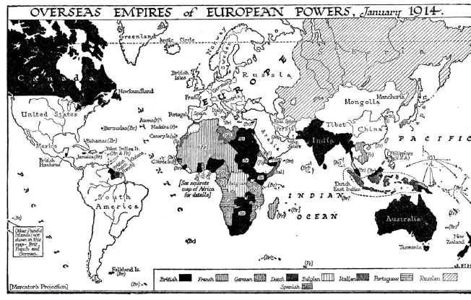

Slide 29
Militarism
Militarism means that the army and military forces are given a high profile by the government.
The growing European divide had led to an arms race between the main countries. The armies of both France and Germany had more than doubled between 1870 and 1914 and there was fierce competition between Britain and Germany for mastery of the seas.
The British had introduced the 'Dreadnought', an effective battleship, in 1906. The Germans soon followed suit introducing their own battleships.
The German, Von Schlieffen also drew up a plan of action that involved attacking France through Belgium if Russia made an attack on Germany.

Slide 30
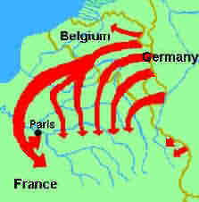

Slide 31
Nationalism
Nationalism means being a strong supporter of the rights and interests of one's country.
  The Congress of Vienna, held after Napoleon's exile to Elba, aimed to sort out problems in Europe. Delegates from Britain, Austria, Prussia and Russia (the winning allies) decided upon a new Europe that left both Germany and Italy as divided states.
Strong nationalist elements led to the re-unification of Italy in 1861 and Germany in 1871.
The settlement at the end of the Franco-Prussian war left France angry at the loss of Alsace-Lorraine to Germany and keen to regain their lost territory.
Large areas of both Austria-Hungary and Serbia were home to differing nationalist groups, all of whom wanted freedom from the states in which they lived.

Slide 32
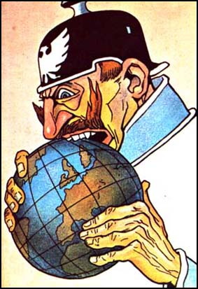
Britain
Aim of expansion threatened
British interests in the Turkish
Empire, Africa and the Far East.
Threat to British Naval Superiority.
Russia
Support to Austria-Hungary in the Balkans-infuriated Russia.
France
Challenged the Entente Cordiale by interfering with Morocco.
Weltpolitik
Notes:
"Weltpolitik" ("world policy") was the foreign policy adopted by the Kaiser Wilhelm II of Germany in 1891, which marked a decisive break with former "Realpolitik", and referred to Germany's foreign policy.

Slide 33
Crises
Moroccan Crisis
In 1904 Morocco had been given to France by Britain, but the Moroccans wanted their independence.
In 1905, Germany announced her support for Moroccan independence.
War was narrowly avoided by a conference which allowed France to retain possession of Morocco. However, in 1911, the Germans were again protesting against French possession of Morocco.
Britain supported France and Germany was persuaded to back down for part of French Congo.

Slide 34
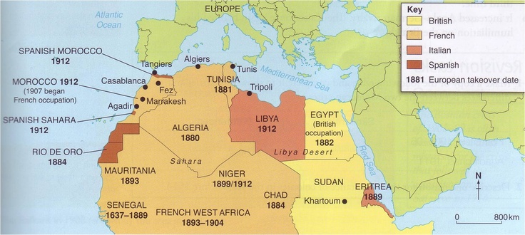
Notes:
On this day in 1905, Kaiser Wilhelm of Germany arrives in Tangiers to declare his support for the sultan of Morocco, provoking the anger of France and Britain in what will become known as the First Moroccan Crisis, a foreshadowing of the greater conflict between Europe’s great nations still to come, the First World War.
The Kaiser did not have any substantive interest in Morocco; neither did the German government. The central purpose of his appearance was to disrupt the Anglo-French Entente, formed in April 1904. The Entente Cordiale, as it was known, was originally intended not as an alliance against Germany but as a settlement of long-standing imperialist rivalries between Britain and France in North Africa. By its terms, Britain could pursue its interests in Egypt, while France was free to expand westward from Algeria into Morocco, the last territory that remained independent in the region. France subsequently signed an agreement with Spain dividing Morocco into spheres of influence, with France receiving the greater part.
Angered by its exclusion from the decisions made about North Africa, Germany believed that the Anglo-French Entente went a long way towards the creation of a new diplomatic balance in Europe itself. An international convention had guaranteed the independence of Morocco in 1880; Germany now saw that the friendship between two of Europe’s most powerful nations threatened to override this, and thus also posed a challenge to Germany’s own influence in Europe and the world.
With much pomp and circumstance, Wilhelm—whose ship had faced gale-force winds on its passage to North Africa—arrived in Tangiers on March 31, 1905. In what would be known as the open door speech, he announced that he looked upon the sultan of Morocco as the ruler of a free and independent empire subject to no foreign control and that he himself would always negotiate with the sultan. He also stated that he expected Germany to have advantages in trade and commerce with Morocco equal to that of other countries. Wilhelm’s sensational appearance marked an aggressive departure from the German foreign policy under the legendary Otto von Bismarck, who as chancellor had united the German empire in 1871 and had advocated conciliatory gestures towards France and other European rivals as a key part of German foreign policy.
Although Germany had intended aggressive action in Morocco to place a wedge between France and Britain, it in fact had the opposite effect, strengthening the bond between the two countries due to their mutual suspicion of Germany. What began as mere friendship turned, after the First Moroccan Crisis, into a type of informal military alliance, including conversations between the British and French governments and military staffs and later, a mutual defense agreement with a third country, Russia.
In the wake of the kaiser’s appearance, an international conference convened in Algeciras, Spain, in January 1906 to conclude an agreement about Morocco. The resulting convention awarded France a controlling interest in Moroccan affairs, but guaranteed equality of trade and economic freedom for every nation and limited any colonial action by any nation without consultation with the other signatories. A Second Moroccan Crisis flared in April 1911, when the French pushed troops into the country, claiming to be defending the sultan against riots that had erupted in Fez but actually violating the terms of the Algeciras convention. In response, Germany sent its own warship, the Panther, which arrived in the port of Agadir on May 21, intensifying the enmity between the two nations and, by extension, their allies.
Slightly more than two years before the outbreak of World War I, then, the two Moroccan crises left no doubt that the traditional power balance in Europe had shifted into large blocs of power, with Germany relatively isolated on one side—enjoying only lukewarm support from Austria-Hungary and Italy—and Britain, France, and Russia on the other.

Slide 35
Notes:
Six years after the First Moroccan Crisis, during which Kaiser Wilhelm’s sensational appearance in Morocco provoked international outrage and led to a strengthening of the bonds between Britain and France against Germany, French troops occupy the Moroccan city of Fez on May 21, 1911, sparking German wrath and a second Moroccan Crisis.
In March 1911, French authorities claimed, rebel tribes staged an uprising in Morocco, endangering one of the country’s capital cities, Fez. The sultan appealed to France for help restoring order, which led the French to send their troops to Fez on May 21. Germany, however, wary of French power in Africa, believed the French had fomented the tribal revolt to create an excuse to occupy Morocco. The German foreign secretary, Alfred von Kiderlen-Wachter, neglected to consult key personnel, including the chiefs of the armed forces, before sending a naval cruiser, the Panther, to anchor in the harbor of Agadir on Morocco’s Atlantic coast, asserting Germany’s claims of French aggression on July 1 in an attempt to encourage resistance against the French among the native population.
Though, as in the First Moroccan Crisis, Germany had counted on France’s isolation and eventual submission, this did not prove to be the case, as Britain once again backed France, its partner in the Entente Cordiale of 1904. David Lloyd George, Britain’s chancellor of the exchequer, made this clear in a public address in London at a banquet at the Mansion House on July 21. After Russia too gave its support to France, though somewhat ambiguously, and Austria-Hungary failed to lend Germany even its diplomatic support, the Germans were forced to back down. In the ensuing negotiations, concluding November 4, Germany reluctantly agreed to recognize the French protectorate over Morocco in return for territorial concessions—which they deemed inadequate—in other regions of Africa.
Meanwhile, military talks began between the British and French, and it was decided that their two navies would divide responsibilities, with the French taking control of the Mediterranean and the British the North Sea and the English Channel. As the two countries moved from friendship to alliance—counting Russia as well on their side—in the wake of the Second Moroccan Crisis, a powerful Germany found itself increasingly isolated, with only tenuous support from its fellow Triple Alliance members, Austria-Hungary and Italy. As Helmuth von Moltke, chief of the German general staff, wrote to the German chancellor, Theobald Bethmann von Hollweg in a memorandum dated December 2, 1912: All sides are preparing for European War, which all sides expect sooner or later.

Slide 36
Bosnian Crisis
In 1908, Austria-Hungary took over the former Turkish province of Bosnia. This angered Serbians who felt the province should be theirs.
Serbia threatened Austria-Hungary with war, Russia, allied to Serbia, mobilized its forces. Germany, allied to Austria-Hungary mobilised its forces and prepared to threaten Russia.
War was avoided when Russia backed down. There was, however, war in the Balkans between 1911 and 1912 when the Balkan states drove Turkey out of the area.
The states then fought each other over which area should belong to which state.
Austria-Hungary then intervened and forced Serbia to give up some of its acquisitions. Tension between Serbia and Austria-Hungary was high.
Notes:
he Bosnian Crisis of 1908-09 added to the complex mix of events that led to the outbreak of World War One. The period is often referred to as the “Balkan Powder Keg” - when this turmoil became entangled with imperialist ambitions and alliances it ignited conflict in Europe.
The Balkan region refers to a part of southeastern Europe and includes the countries of Albania, Bulgaria, Serbia and Yugoslavia. In total, the Bosnian Crisis involved nine countries.
The Bosnian Crisis was sparked by anger over the annexation of the Balkan regions of Bosnia and Herzegovina by Austria-Hungary.
In 1878, Bosnia and Herzegovina were officially a part of the Turkish Ottoman Empire, but Austria-Hungary occupied the territory with the agreement of the rest of Europe (Treaty of Berlin).
However, on 6 October 1908, Austria-Hungary announced its decision to annex Bosnia and Herzegovina. The Ottoman Empire decried the move and Britain, Russia, Italy, Montenegro, Serbia, Germany and France saw this as a violation of the Treaty of Berlin and became entwined in the crisis.
Following Austria-Hungary’s announcement, Bulgaria declared its independence from the Ottoman Empire.
The Turks, who had ruled Bulgaria, Bosnia and Herzegovina for centuries, were unsurprisingly displeased with the annexation and declaration of independence.
The Ottoman Empire’s military and domestic power had declined in the past decades. Thus, the Turks could not do much more than demand a financial settlement in exchange for Austria’s annexation of Bosnia and Herzegovina.
The annexation caused international tension, particularly in Russia and Serbia. A strong popular opposition to the annexation developed in Russia. Additionally, Serbia was angered by the annexation of Bosnia and Herzegovina, which she had hoped to unite into one Serbian nation. She demanded Austria to give a portion of Bosnia and Herzegovina to Serbia, and Izvolsky (the Russian Foreign Minister), pressured by anti-Austrian opinion in Russia, had no choice but to support the Serbian claims.
Austria reacted by threatening to invade Serbia. With Germany as an Austrian ally, Russia could not risk a war for Serbia’s sake. In March 1909 Izvolsky notified Germany that Russia accepted Austria’s annexation.
Although a war was avoided, the Bosnian Crisis embittered relations between Serbia and Austria-Hungary. It contributed to the underlying tensions that were ignited when Franz Ferdinand was assassinated at Sarajevo.

Slide 37
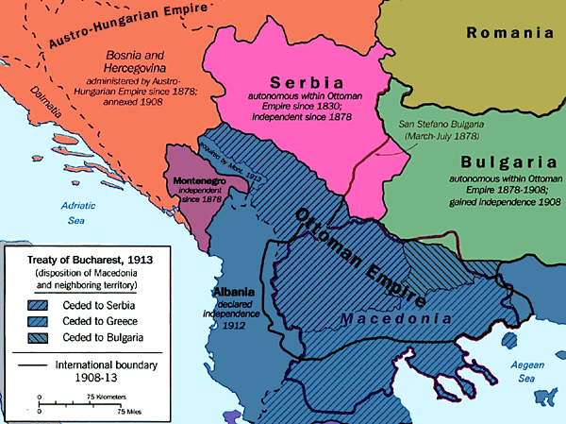

Slide 38
Some important terms
Theatres of War: Historians use this term to denote a geographical area where the fighting took place. (European Theatre, African Theatre, Asian Theatre)
Front: Refers to the area where the fighting was happening. This term is linked to the “front line”. Fronts can move, sometimes very quickly, or they can be stuck in more or less the same place, as happened with the Western Front.
Campaigns: A campaign is a big military plan, with a set of objectives which, you hope, either win the war or at least badly hurt the enemy. Campaigns often involve many battles.

Slide 39
