Slide 1
Schlieffen Plan: 1914

Slide 2
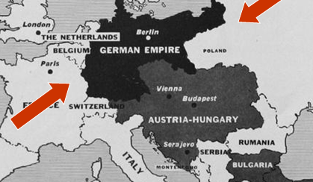
The Idea
Germans started creating & organizing a plan of attack ten years before the war
  Why? They wanted a plan in place so they wouldn’t have to fight a war on two fronts at the same time

Slide 3
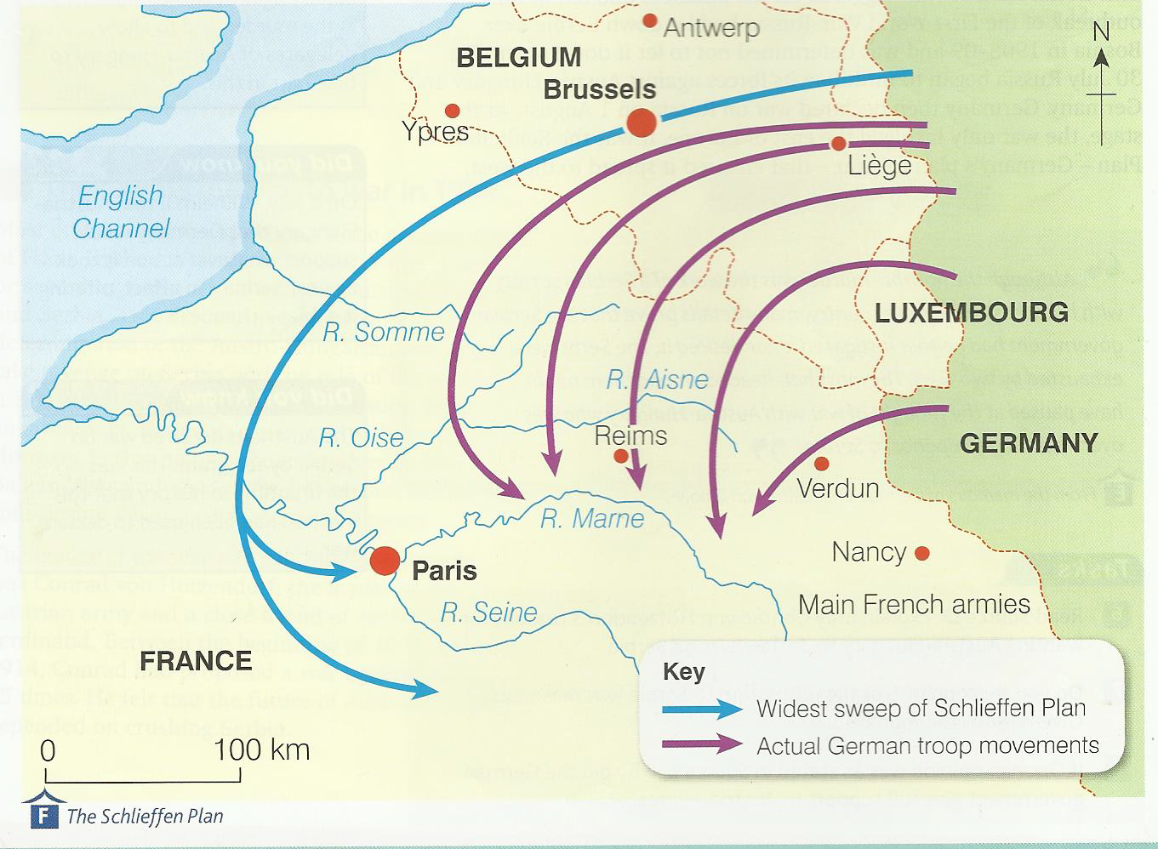

Slide 4
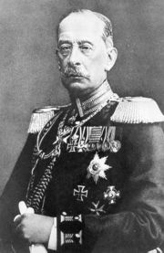
General Von Schlieffen
German General Von Schlieffen developed a six week plan to knock France out of the war before turning attention to the Russians

Slide 5
What was the Germans’ Plan?
The plan was to quickly (6 weeks) capture Belgium and France in the west.
After the capture of France the Germans would turn east to Russia and conquer them.
This plan was based on the assumption that Russia would take too much time to mobilize (to get ready).
The Germans thought it would take them 6 weeks

Slide 6
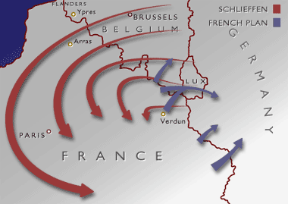
What was the Goal?
Go through Belgium, sticking as close to the coastline of the English channel (water) to get to Paris, the capital of France.

Slide 7
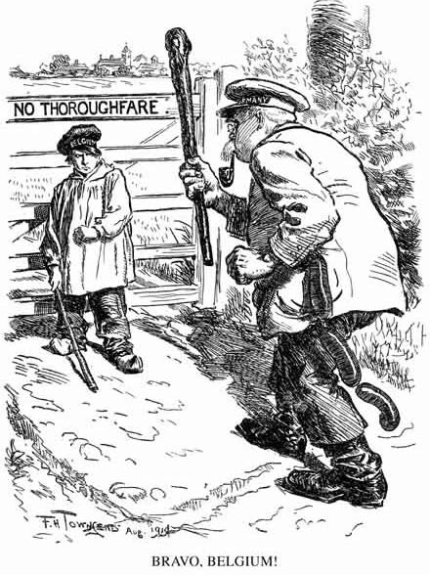
Sometimes plans go awry…
On August 2nd 1914, the German army invaded Belgium.
Belgian resistance was stronger than expected. The Belgian forts at Liège held out for 12 days and Brussels was not occupied until 20th August.
The Germans were held up by the much smaller Belgian army.
Notes:
This famous cartoon appeared in the British satirical magazine Punch, August 12th1914
7

Slide 8
The Western Front and How We Got Involved
The Belgians fought back and slowed the German advance
This tactic drew Great Britain into the war since Great Britain was helping with Belgian neutrality
  They had earlier signed a treaty stating they would interfere if Belgium was attacked
Aug 4 - Great Britain declared war and because Canada’s foreign policy was still tied to them Canada was automatically at war

Slide 9
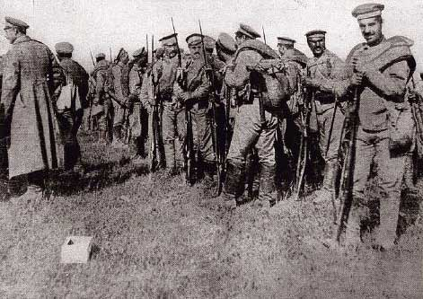
Nobody told the Russians about the Schlieffen Plan!
Russia mobilized in just 10 days (instead of the 6 weeks the Germans thought would take) and Germany was forced to withdraw troops from Belgium to defend her eastern border (on the Russian side).
Notes:
Russian soldiers pictured crossing the German border in August 1914
9

Slide 10
Here’s why it didn’t work:
The Belgians resisted, and the British joined in to help, slowing down the Germans
The Russian forces mobilized much quicker than expected and began invading Eastern Germany, weakening this main force
The German troops could no longer advance on Paris from the back, but had to move in front of the city instead, allowing the French to counter-attack

Slide 11
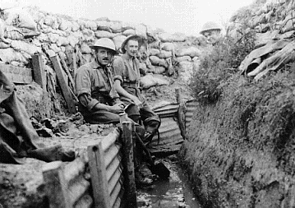
So What?
Instead of a short, swift campaign as anticipated, Germany’s attack on France became a long, costly – and horrible – war

Slide 12
Belgium resisted the German army instead of remaining neutral – this slowed down the German advance
Britain did honour its alliance with France and Russia and sent troops and supplies to France and Belgium
Russia mobilized its army much faster than Germany thought they could and were thus forced to leave ¼ million troops to defend Berlin and fight the Russians

Slide 13
Two young German Generals (Kluck and Moltke) changed the original plan which reduced its effectiveness, their army was bogged down ten miles outside of Paris
The French soldiers fought bravely to defend their country, surprising the Germans. British soldiers were also helping to hold the German advance
Austria did not defeat Serbia quickly and asked Germany for help. The Germans had to offer soldiers and supplies to Austria reducing their force on the Western front

Slide 14
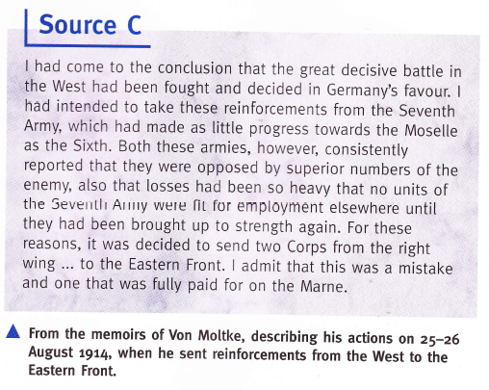

Slide 15
Germany found itself sandwiched between the British and French on the western front and the Russians on the eastern front. The war that was supposed to be over by Christmas was prolonged for four years.

Slide 16
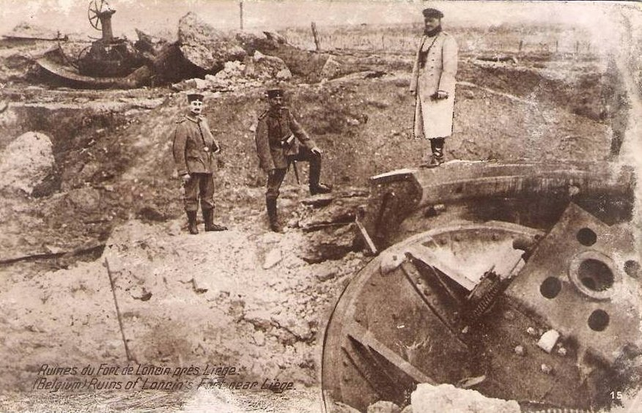

Slide 17
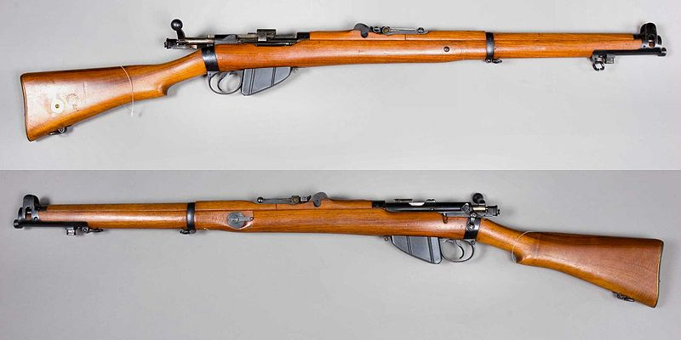
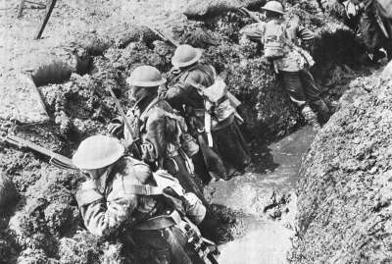
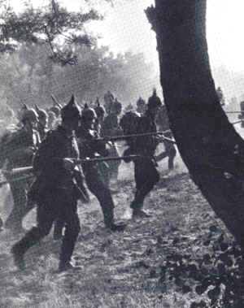
The Battle of Mons
The British were professional soldiers equipped with the new Lee Enfield Mark III rifle.
They were heavily outnumbered, but their rapid and accurate rifle fire slowed down the advance of the German conscripts.
One German officer wrote in a letter: ‘It seemed as though there was a machine gun behind every bush’

Slide 19
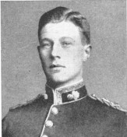
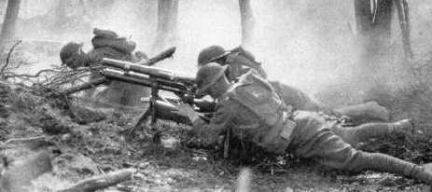
The Battle of Mons
“At the Nimy bridge, Maurice Dease took control of his machine gun after every other member of his section had been killed or wounded and continued to fire the weapon despite being shot multiple times.”
“Only after being wounded for a fifth time was he evacuated to the battalion aid station, where he died.”

Slide 20
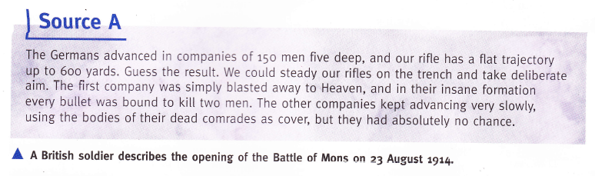

Slide 21
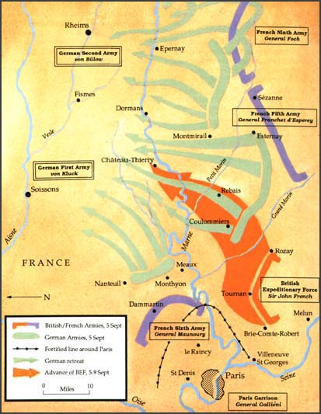
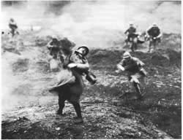
Why did it fail?
The Belgian and British forces managed to slow down the German offensive and forced the German right flank to turn South.
This gave French forces enough time to rush troops into Paris to defend the city. The Germans met French forces on 5th September along the River Marne.
The Battle of the Marne lasted 8 days and forced the Germans to fall back to the River Aisne. Joffre, the French Commander-in-Chief, played a crucial role in rallying the French forces at the Marne.

Slide 22
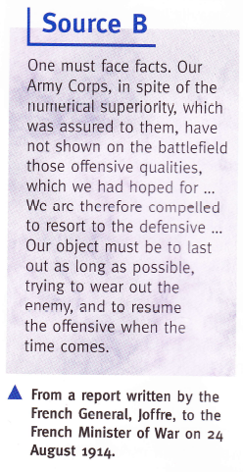

Slide 23
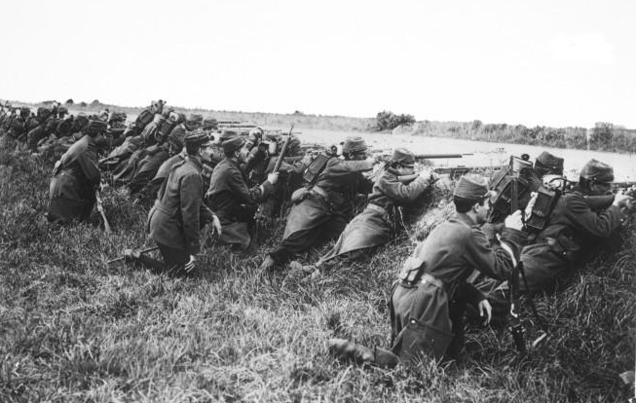

Slide 24
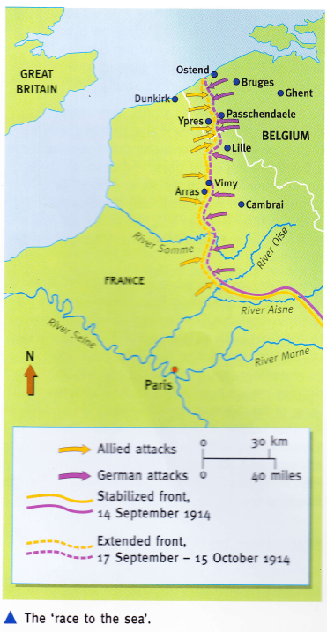
The Race to the Sea
After losing the Battle of the Marne, German forces retreated to the River Aisne and dug trenches for extra protection.
From 10th October onwards, the two armies attempted to outflank each other by advancing to the North Sea.
This was important because the Germans took Ghent, Bruges and Ostend, but failed to take any of the Channel ports.

Slide 25
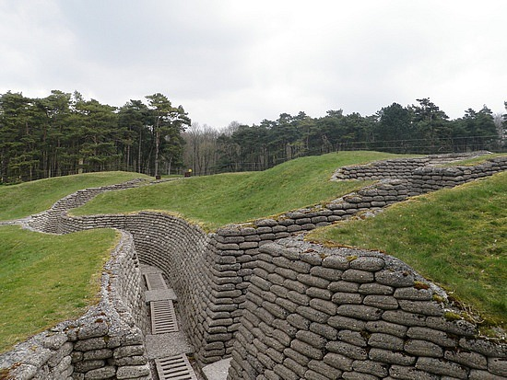
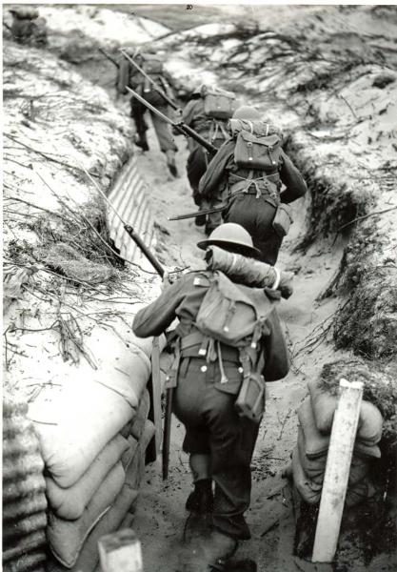
The Race to the Sea
By the end of the year, a front line had been established that was to remain largely in place until early 1918.
As each side had built trenches sideways in order to try to outflank each other, a complex system of trenches – with connecting, reserve and communication trenches – soon extended for miles across Belgium and France.

Slide 26
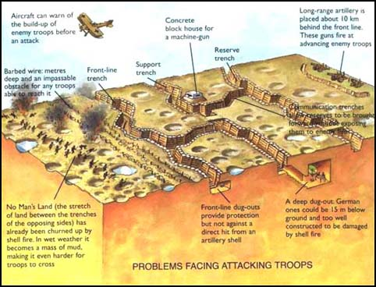

Slide 27
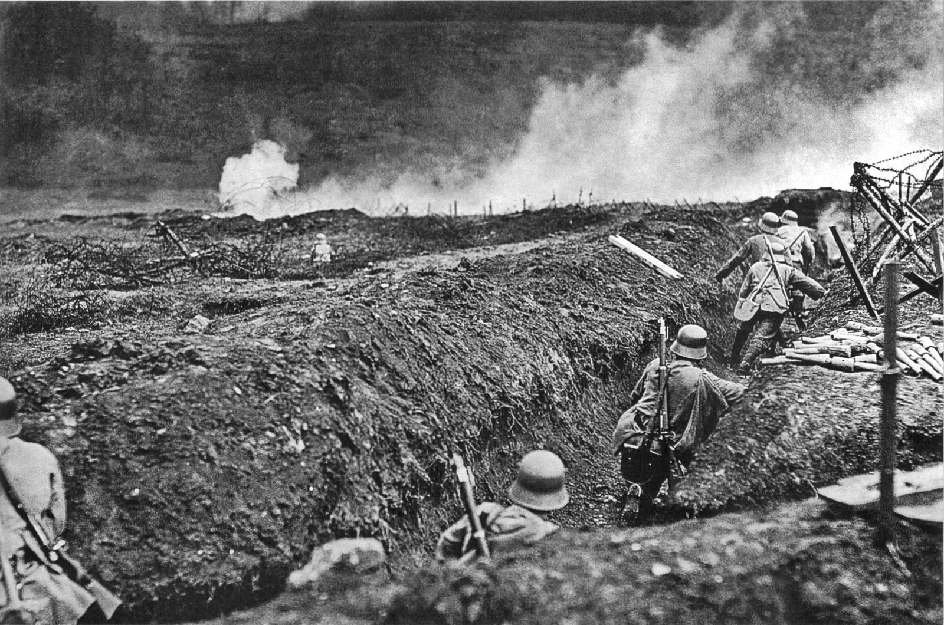

Slide 28
Theatres of War

Slide 29
Although World War One was a world war, most of the fighting was confined to a few key areas.
These areas are usually referred to as the theatres of war.

Slide 30
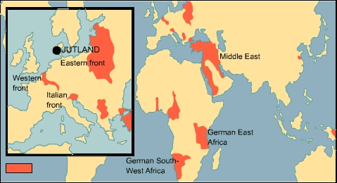

Slide 31
Western Front
The war in the west began with a German invasion of Belgium (August 3, 1914) and France, and when this was pushed back, both sides dug in and took shelter in trenches.
  To avoid losing the territory already gained in France, the Germans began digging trenches. The British and French, unable to break through the line of trenches, began to dig their own trenches. Throughout the entire war, neither side gained more than a few miles of ground along what became known as the western Front.
Although each side did make some advances, this line of trenches remained fairly static, despite some hug battles, until 1918.

Slide 32
The German army crossed the Belgian border on August 3rd 1914.
Britain and France declared war on Germany on August 4th.
The Germans pushed through Belgium and entered France.
The British and French armies marched to stop the German advance. The Battle of Marne 4th - 10th September stopped the Germans from marching on Paris.
To avoid losing the territory already gained in France, the Germans began digging trenches.
The British and French, unable to break through the line of trenches, began to dig their own trenches.
Throughout the entire war, neither side gained more than a few miles of ground along what became known as the western Front.

Slide 34
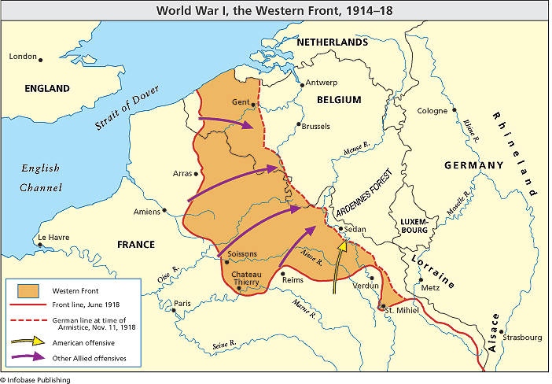

Slide 35
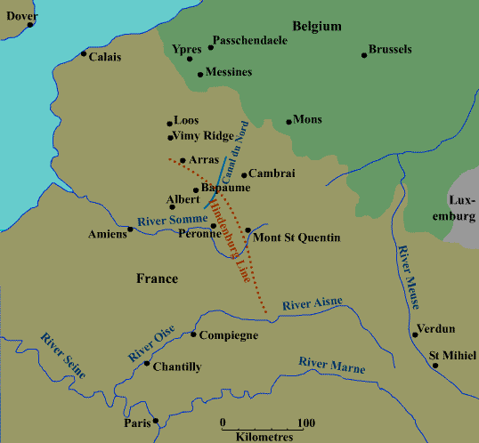

Slide 36
Eastern Front
The line of fighting on the Eastern side of Europe between Russia and Germany and Austria-Hungary is known as the Eastern Front.
Fighting began on the Eastern front when Russia invaded East Prussia on 17th August 1914. Germany immediately launched a counter-offensive and pushed Russia back. This pattern of attack and counter-attack continued for the first two years of the war and meant that the Eastern Front changed position as land was captured and lost by both sides.
By 1917, the Russian people were fed up with the huge number of Russian losses. The government and monarchy were overthrown and the new Bolshevik government signed the treaty of Brest Litovsk which took the Russians out of the war.

Slide 37
Although trenches were dug in the Eastern Front, they never dominated the scene in quite the way they did in the west. The Eastern Front was more a war of movement. Like the Western Front, though, it was huge. In the north, it ran through Poland and western Russia, where the Germans and Russians faced up to each other. Then the Front ran south through southern Poland and into Czech and Slovak territory, into the area where the Russians faced the Austro-Hungarians. Romania entered the war in 1916, thus extending the Eastern Front even farther south.

Slide 39
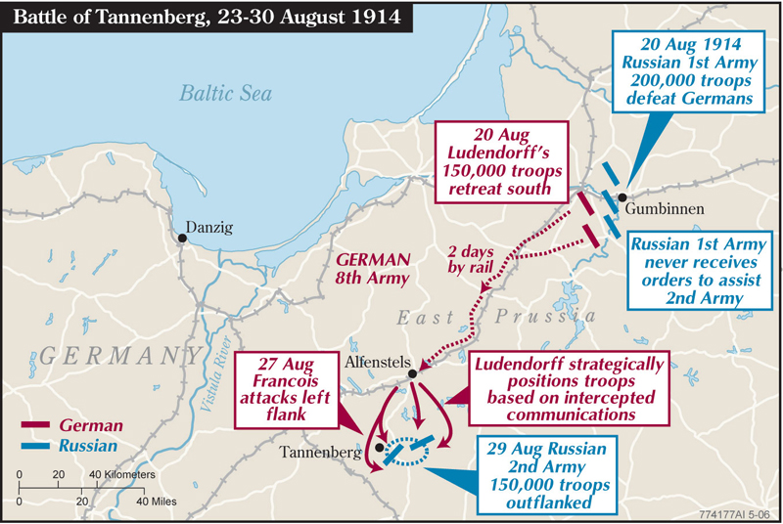

Slide 40
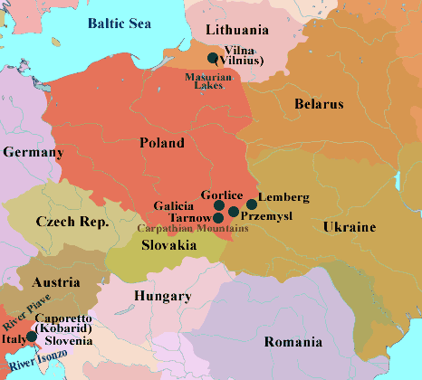

Slide 41
The Southern Theatre
Before the outbreak of war in August 1914, Italy had sided with Germany and Austria-Hungary.
However, tempted by offers of more land once the war was won, Italy entered the war in April 1915 on the side of the allies.
The Italian front is the name given to the fighting that took place along the border between Italy and Austria. The Italians only managed to advance a short way into Austria.
Between 1915 and 1917 there were twelve battles fought along the river Isonzo, just inside the Austrian border, all of which were inconclusive.
After being defeated at the battle of Caporetto in 1917, the Italians were pushed back.

Slide 42
The Southern Theatre
This Alpine war was extremely dangerous and costly but it often gets overshadowed by the Western Front.
Bulgaria joined in the war on Germany’s side, so fighting took place along its borders too.
Austria’s border with Serbia was where the fighting actually began, but after Serbia was overrun in 1915, the British and French opened another front against the Austrians, in northern Greece.

Slide 44
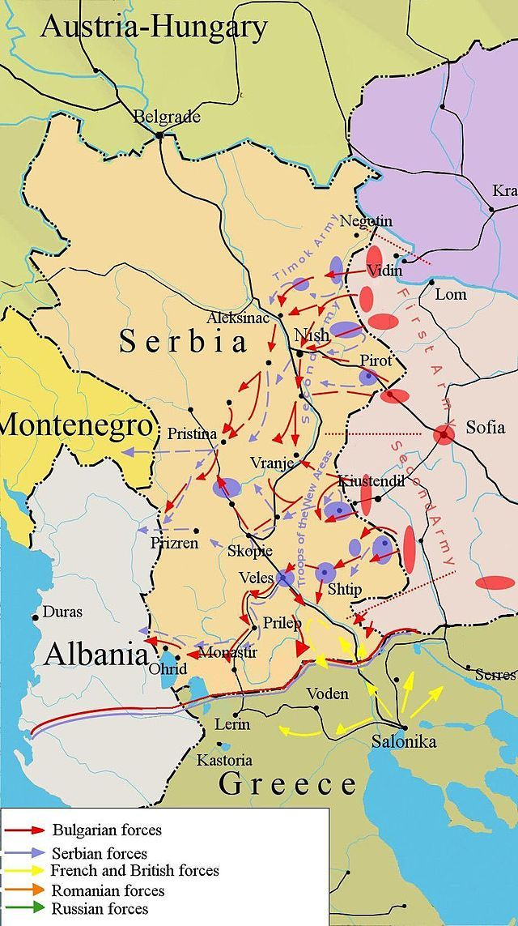

Slide 45
The Turkish Theatre
Turkey entered the war with the Central Powers. This was to prevent the Russians from using the straits of the Gallipoli Peninsula (a water passage that would allow Russians to access the Balkans from the Black Sea)
A major anti-Turkish rebellion started up in Arabia and the British launched an offensive from Egypt that moved northwards through Palestine and Syria.

Slide 46
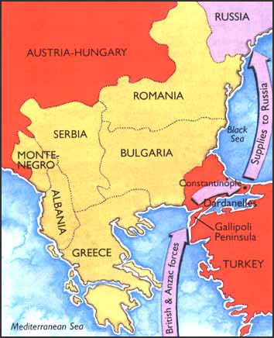
The Gallipoli Campaign
Russia wanted an all-weather port
Great Britain wanted Gallipoli to open a supply line to Russia, and to have another way of attacking Austria-Hungary and Germany

Slide 47
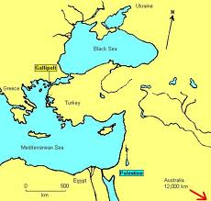
Gallipoli
The Gallipoli peninsula is located in the south of Turkey.
In 1915, the allied commanders decided to try to attack Germany by attacking her ally, Turkey.
Allied soldiers, mainly from Australia and New Zealand, were sent to the Peninsula while British ships tried to force a way through the Dardanelles.
The entire mission was a failure. The allies lost more than 50,000 men but gained hardly any land.

Slide 48
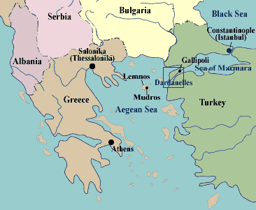

Slide 49
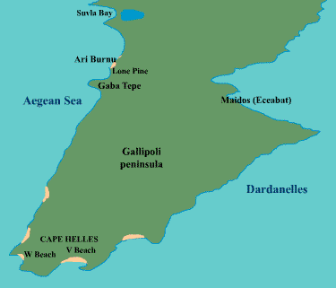

Slide 50
The African Theatre
Britain, France, Belgium and Germany all had colonies in Africa and the outbreak of war in Europe set the Allied countries up against the German ones.
The Germans were outnumbered but their commander in east Africa conducted a guerrilla campaign. Fighting in Africa stretched from German South-West Africa, thought he centre of the continent to Kenya and East Africa.

Slide 51
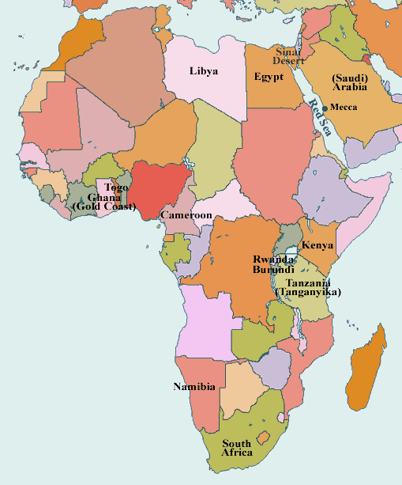

Slide 52
The pacific Theatre
The Australians and New Zealanders attacked Germany’s Pacific colonies. The Japanese were keen to contribute their bit to the Allied war effort by attacking German possessions in China and the Pacific.
They also took the opportunity to start taking Chinese territory until China came into the war on the same side and the Allied leaders asked the Japanese to refrain from attacking their ally.

