Slide 1
Weapons

Slide 2
World War I forever changed the face of warfare. New technology yielded millions of casualties.

Slide 3
During WWI, a wide variety of weapons were used:
Guns
The main weapon used by British soldiers in the trenches was the bolt-action rifle. 15 rounds could be fired in a minute and a person 1,400 metres away could be killed.

Slide 4
The first Machine guns needed 4-6 men to work them and had to be on a flat surface. They had the fire-power of 100 guns.
Machine guns became the most important weapon in trench warfare. They were fast, easy to reload and fired at long range.
  They fired hundreds of rounds of ammunition without stopping, but they were too heavy to pick up and carry and would have to be placed on stands.
Repeating rifles (Ross Rifle, Lee Enfield Rifle) were good for long distances, but hard to reload in the trenches due to the mud, which would cause them to jam.

Slide 5
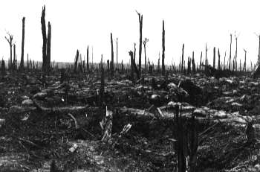
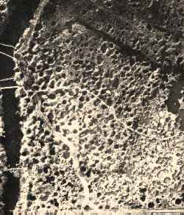
Artillery became more powerful
For much of the war, all day, every day, artillery would pound the enemy’s trenches with hundreds of shells. Bombardments caused more casualties than any other weapon.
In 1914, artillery was not very accurate and often bombarded their own front-lines before getting their range right!
By 1918, artillery was much bigger, and was much more accurate. It became the key weapon.

Slide 6
Large field guns (artillery) had a long range and could deliver devastating blows to the enemy but needed up to 12 men to work them. They fired shells which exploded on impact.
This caused a lot of destruction, were fast and good to launch into enemy trenches with little or no risk to self.
Grenades were only useful when they were close enough to the enemy to threw it into their trenches.

Slide 7
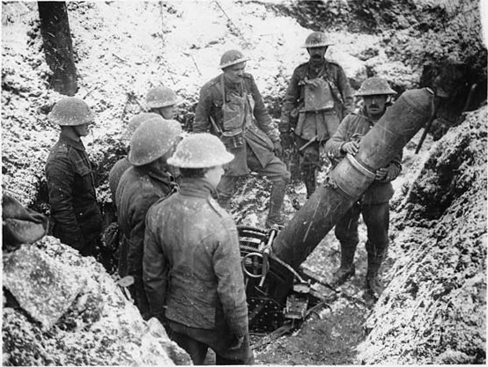
9.45 inch British Trench Mortar

Slide 8
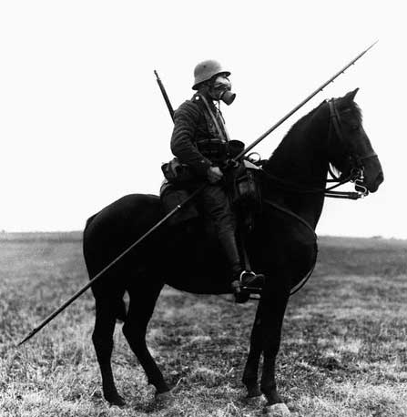
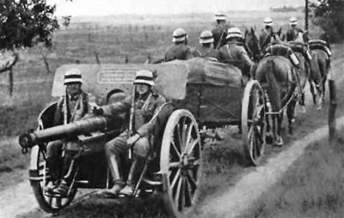
Cavalry became less important
Cavalry units were initially used by all sides but their vulnerability soon became apparent. But they were used for:
  Logistical Support
  Reconnaissance
  Pulling artillery, ambulances and supply wagons
  Diversionary Attacks
Horses couldn’t function in the mud & trenches
Tanks ultimately replaced cavalry in shock tactics.

Slide 9
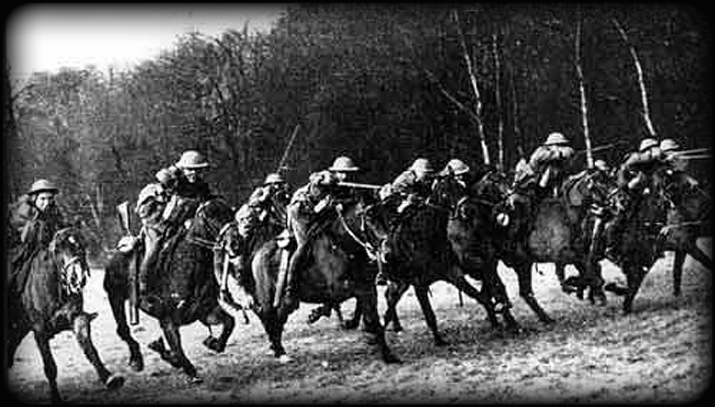

Slide 10
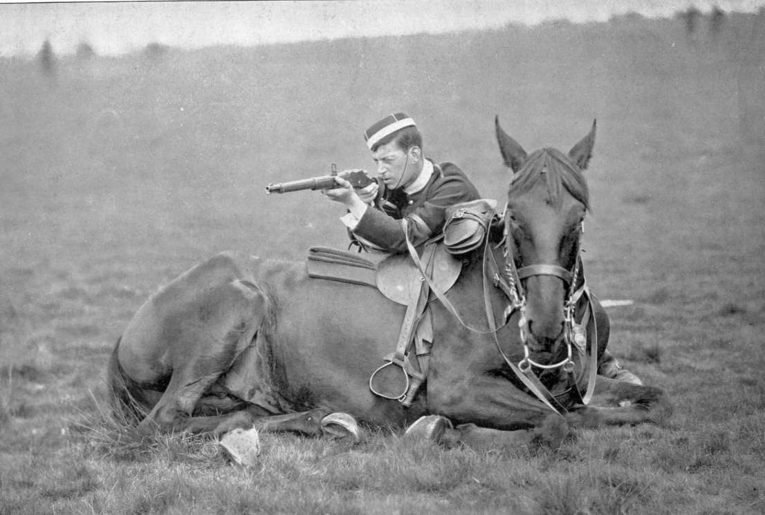

Slide 11
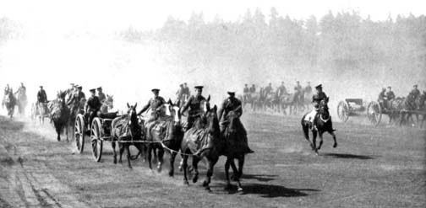

Slide 12
Tanks
The first tank was called ‘Little Willie’ and needed a crew of 3. Its maximum speed was 3mph and it could not cross trenches.
The more modern tank was not developed until just before the end of the war. It could carry 10 men, had a revolving turret and could reach 4mph.
Tanks were used for the first time in the First World War. They were developed to cope with the conditions on the Western Front.
First used by the British at the Battle of the Somme, scaring the German soldiers who had not yet seen a tank.

Slide 13
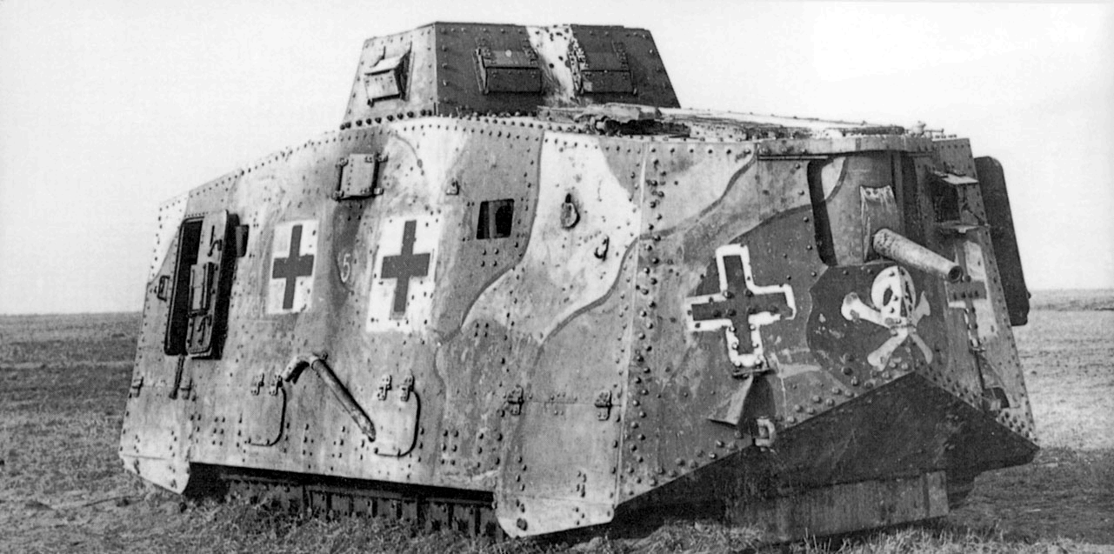

Slide 14
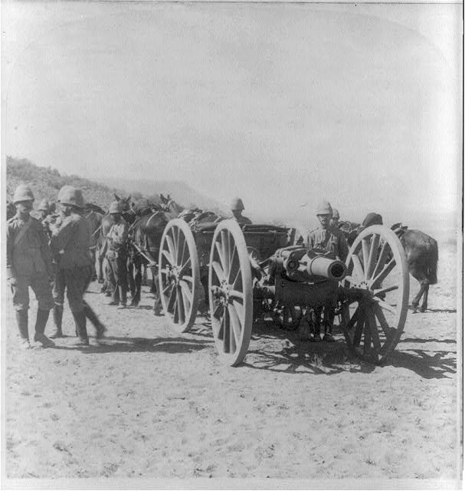
British howitzer battery during the Boar War 1900

Slide 15
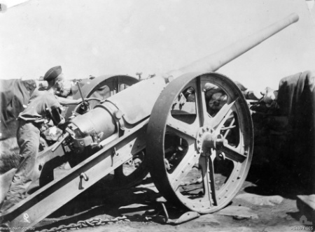
4.7 inch (120mm) British Naval Gun adapted for use by the army during the Boer War

Slide 16
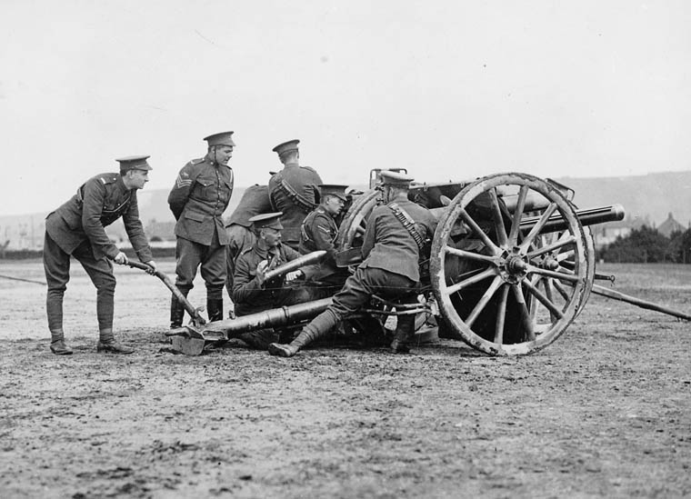
The British 18 pounder artillery cannon was the most commonly used artillery piece during the war

Slide 17
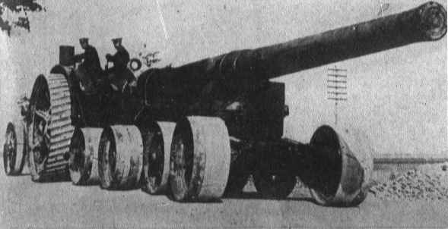
British heavy artillery

Slide 18
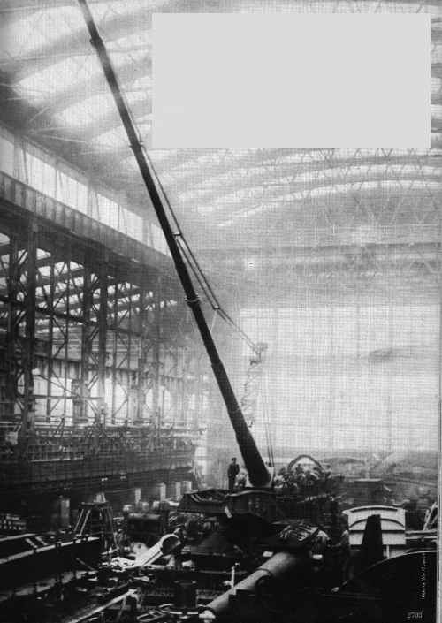
The German ‘Paris Gun’ could fire over 75 miles but had little accuracy. Length = 34 m / Weight = 138 tons

Slide 19
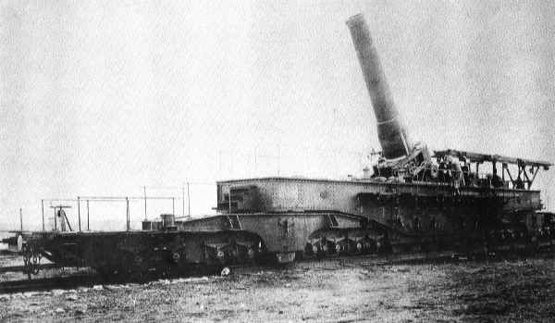
French 52cm Howitzer – biggest gun of WW1

Slide 20
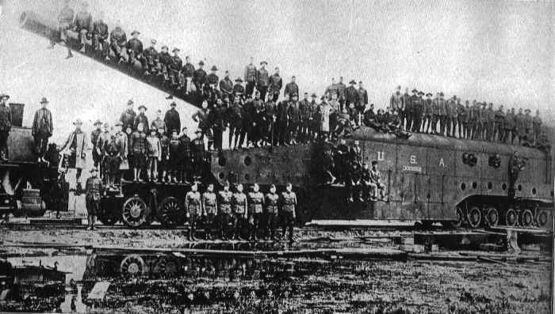
American railroad artillery, 14 inch shells

Slide 21
Gas
Mustard gas was the most deadly weapon used. It was fired into the trenches in shells. It is colourless and takes 12 hours to take effect. Effects include – blistering skin, vomiting, sore eyes, internal and external bleeding. Death can take up to 5 weeks.
The German army were the first to use chlorine gas at the battle of Ypres in 1915. Chlorine gas causes a burning sensation in the throat and chest pains. Death is painful – you suffocate! The problem with chlorine gas is that the weather must be right.

Slide 22
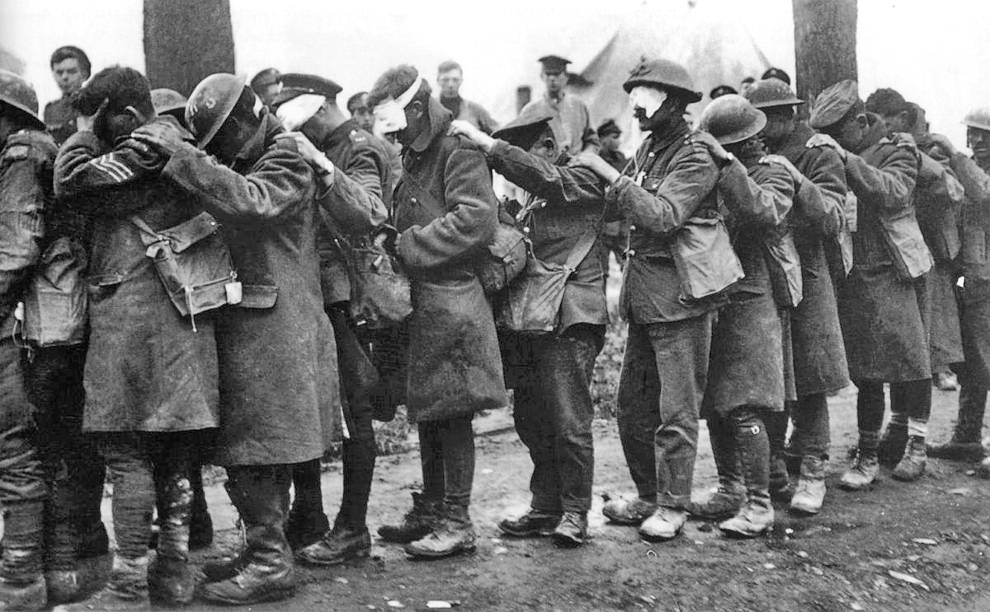

Slide 23
The War at Sea

Slide 24
Even before the war, Germany and Britain were involved in a naval race.
  Germany knew that she was unlikely to win a naval war against Britain and avoided naval conflict with Britain.
The British produced the Dreadnought battleship. Germany produced their own version of the Dreadnought shortly afterwards.

Slide 25
The Deadnought was useful for bringing supplies, but it was an easy target for U-boats.
They usually travelled in convoys, often surrounded by other battleships for protection.

Slide 26
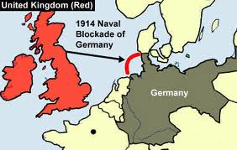
Britain's main naval tactic was to keep German ships in German ports and to block supplies from reaching Germany.
Germany's main naval tactic was to post U-boats (submarines) in the Atlantic Ocean and to destroy ships taking supplies from America and other countries to Britain.

Slide 28
Which country would be favourite to win the war in the North Sea?
British Navy | German Navy
The British had the largest fleet, with 29 dreadnoughts. These were anchored at Scapa Flow, a protected and sheltered bay in the Orkney islands, and at Cromarty. The battle cruisers were at Rosyth. | The German fleet was smaller, with only 17 dreadnoughts in 1914. The German High Seas Fleet spent most of the time at its base in Wilhelmshaven.
The British also had a long naval tradition, having controlled the seas throughout the 19th century. | Germany had no naval tradition. The Kaiser had built up the navy in the preceding 14 years.
Britain had one more advantage. Early in the war a German cruiser, Magdeburg, was sunk by Russian ships in the Baltic Sea. The body of a German officer was found clutching the German naval code book. From then on Britain was able to decode German messages and knew when enemy ships were leaving port. | Germany did have several advantages: The German ships were of superior design, especially in the quality of their steel armour protection. The German gunners proved themselves to be superior marksmen. Most German shells, unlike their British counterparts, exploded on hitting enemy ships.

Slide 29
By winning the war at sea, Germany hoped to starve Britain into submission by cutting all imports from this island nation.
German and British naval forces actually only met in one major battle–the Battle of Jutland.
  Britain fared horribly, losing 6000 soldiers, though the fleet remained large enough to defend the British Isles.
As a result, the German navy returned to port and never sailed out again. British naval blockades against Germany continued, successfully, until the nation was almost completely devoid of supplies.
In retaliation, Wilhelm ordered a policy of “unrestricted submarine warfare.”

Slide 30
One of the most important casualties of Wilhelm’s “unrestricted submarine warfare” was the Lusitania.
  The Lusitania sank on May 7, 1917.
  It was just approaching Ireland when a torpedo that had been shot from a German U-boat struck it. It took only 18 minutes for the Lusitania to sink.
  Of the 1,916 people on board, 1,198 were killed.
  Those killed included passengers and crew members that were on the ship (it was not a warship).
  The dead passengers included many Canadians and 115 neutral American citizens.

Slide 31
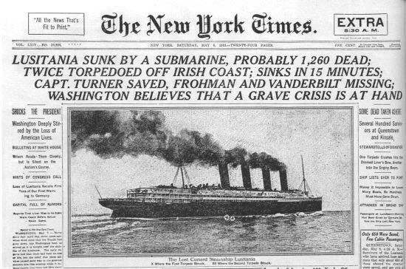

Slide 32
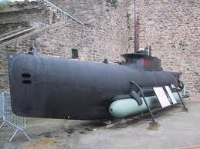
U-Boats
U-Boasts could destroy warships and merchant ships
February 1917, Germany declared that U-boats would sink any ship approaching Britain
In 4 months U-boats sank 1,000 Allied ships
Torpedoes were used by submarines. The Germans used torpedoes to blow up ships carrying supplies from America to Britain.

Slide 33
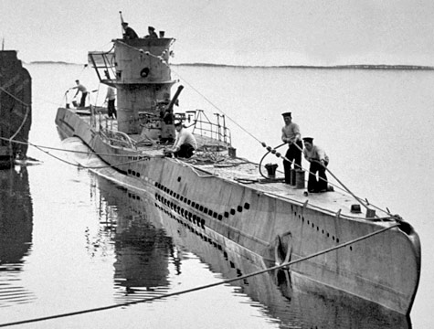

Slide 34
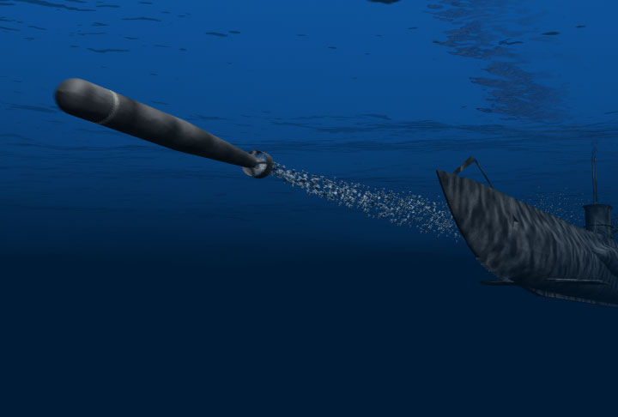

Slide 35
The sinking of the Lusitania pushed the United States to finally enter the First World War by declaring war against Germany.

Slide 36
The War in the air

Slide 37
Planes
Planes were also used for the first time. At first they were used to deliver bombs and for spying work but became fighter aircraft armed with machine guns, bombs and some times canons.

Slide 38
Development of Airplanes
Originally used for aerial reconnaissance, then armed with pistols and rifles
Both Allies and Central Powers built small fighter aircrafts with machine guns mounted on
Young men wanted to avoid trench warfare, and to have a chance for glory
Germany had many more planes then the British and French

Slide 39
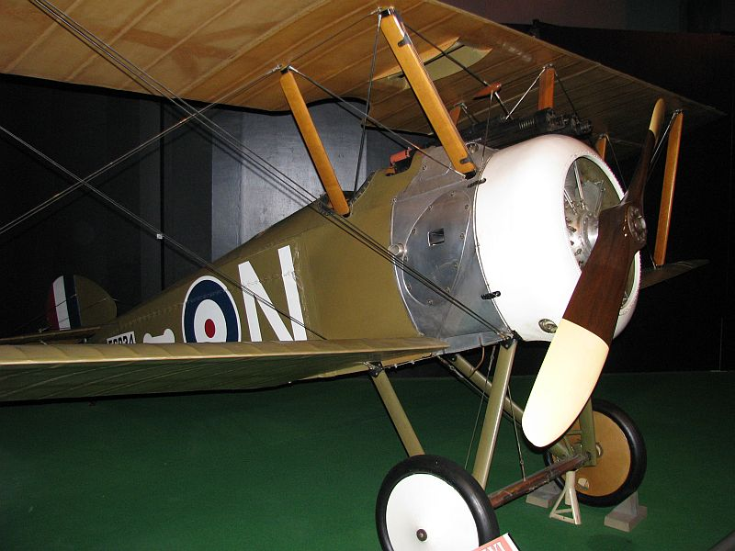

Slide 40
Air Fighting Techniques
Aerial fights between pilots were called ‘dogfights’: planes attacked from the rear and then fired
When a plane was hit, pilot was helpless, parachutes not used until later in the war

Slide 41
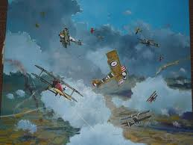

Slide 42
Air Fighting Techniques
At the beginning of the war, bombing from planes was very primitive
Pilots would fly with bombs on their lap
  By the middle of the war, pilots brought bricks and dropped them over the side
Later in the war, plane fighting became much more advanced
  By the end of the war, they were equipped with machine guns (pilots often shot off their own propeller until the Germans developed a timing device solved that problem)

Slide 43
Role of the Pilot
Pilots built reputations on their abilities to manoeuvre in the air and shoot down enemies
An ace was somebody who could prove that they had shot down at least 5 enemy planes

Slide 44
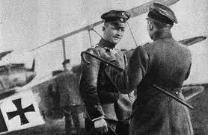
Role of the Pilot
Germany’s greatest ace was Baron von Richthofen, he was known as the “Red Baron”
Billy Bishop was Canada’s top ace with 72 kills

Slide 46
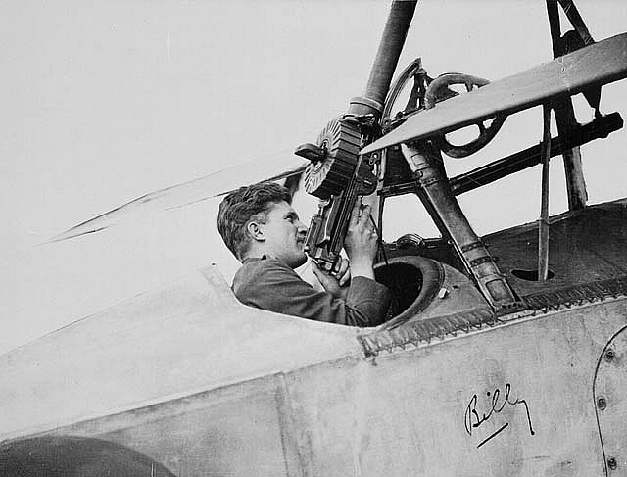
Billy Bishop
Awarded Victoria Cross for bravery (a British military honour for courage and bravery)

Slide 47
Role of the Pilot
Many casualties of the war in the air were a result of mechanical failure
By 1916, the average life of a pilot was only 3 weeks.

Slide 48
Zeppelin
The Zeppelin, also known as blimp, was an airship that was used during the early part of the war in bombing raids by the Germans. They carried machine guns and bombs.
However, they were abandoned because they were easy to shoot out of the sky.

