Slide 1
Air, Land & Sea

Slide 2
War in the Air: What has Changed?
Radar
Radar was a technology that allowed land bases to detect incoming aircraft and direct their anti-air defenses in the direction of the incoming aircraft.
Radar was also used in an offensive strategy by giving aircraft the ability to attack targets at night and during inclement weather.

Slide 3
Britain's use of radar allowed them to defend against German air attacks because they knew where the majority of the German air force was heading.
Although Germany still inflicted major damage during their air raids, without the forewarning from radar, the damage that Britain experienced could have been dramatically more wide spread.

Slide 4
The use of radar almost prevented the attack on Pearl Harbor in 1941
The attack on Pearl Harbor in 1941 could have been avoided because of the active use of radar. On the morning of December 7th, almost an hour before the first Japanese plane attacked, a mobile radar stationed on the north side of Oahu detected the approach of the Japanese aircraft.
The operators reported the sighting to their superiors but their report was dismissed because the operators were thought to be inexperienced.
Had the reports made by the radar operators been acted upon the Japanese attack on Pearl Harbor could have been completely averted. The history of World War II as we know it would have been entirely different…

Slide 5
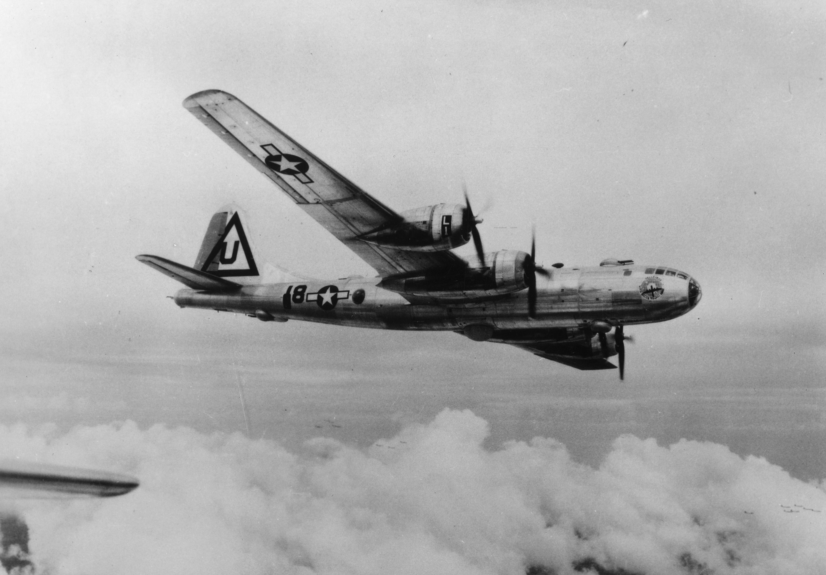
War in the Air: What has Changed?
B-29 Bomber
The B-29 was designed to fly further, higher, and carry more weight than its predecessor, the B-17.
It was created to meet the practical requirements of aerial warfare.
The B-29 first saw combat over Asia in June 1944.
About 4000 B-29s were made during the war.

Slide 6
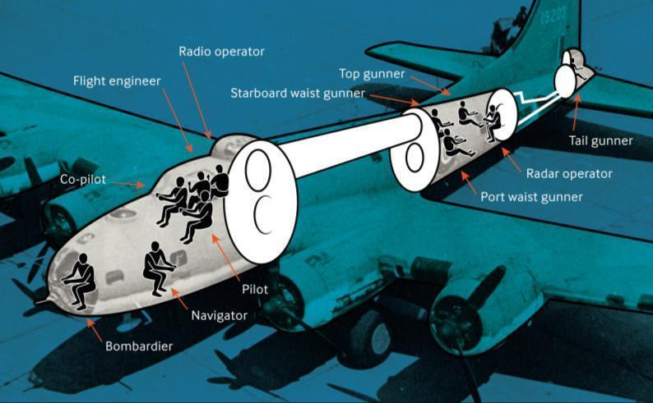
Pressurised Cabins
To fly at high altitudes, the B-29 had to be pressurised to simulate a low altitude environment for the crew. This allowed to crew to fly at over 12,000ft, breathe normally and stay warm. Only the areas the crew used were pressurised such as the nose, middle crew areas and tail gunners compartments and were connected via a tunnel.
x close

Slide 7
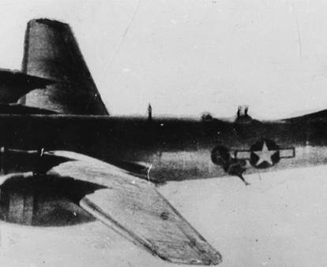
If the pressurised crew areas were damaged the temperature immediately dropped to minus 30 degrees.
If crew were not strapped in, they could be sucked out of any hole in the body of the plane like Sergeant Krantz in this photo.
  He survived the ordeal, pulled back in by his straps.

Slide 8
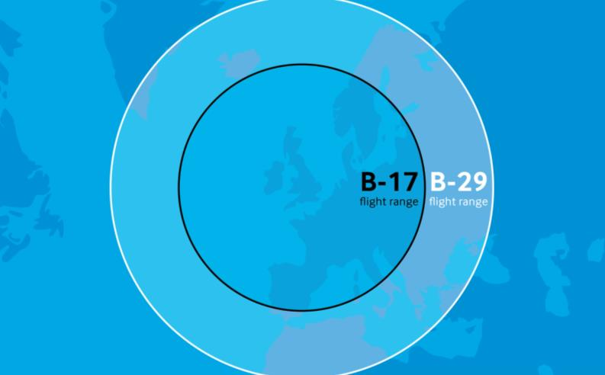
Increased Range
Sufficient range was needed to attack Japan. The B-29 could fly further, capable of intercontinental flight. The maximum range of the B-29 was 5,600 miles, dependent on bomb load.

Slide 9
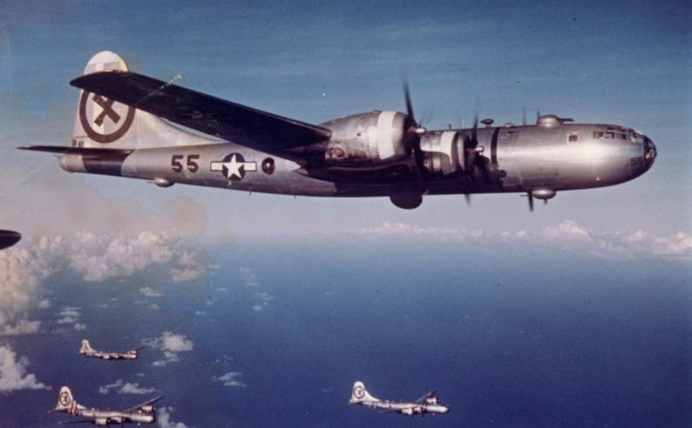
Weight Reduction: Camouflage
B-29s were not generally painted as the weight of paint would reduce the range and when flying at high altitudes, camouflage made no difference as to whether an aircraft could be seen or not.
© IWM (FRE 11984)

Slide 10
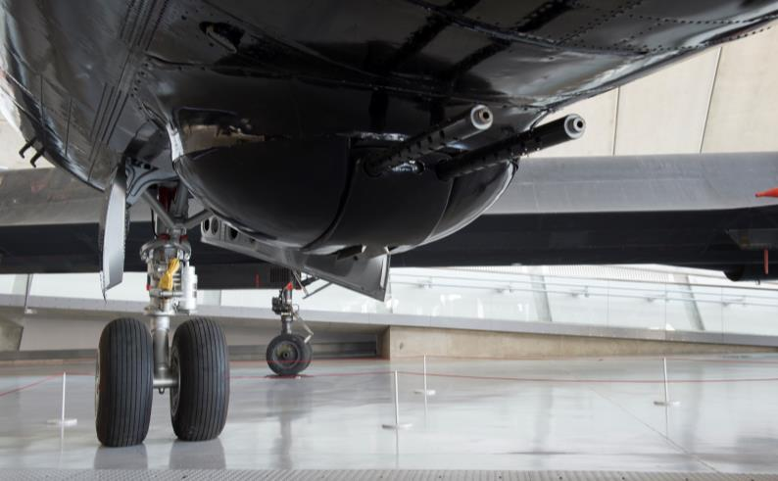
Using guns at higher altitudes
Traditional manned turrets were not suitable for the high altitude, so a system of remote–control guns was introduced. Four turrets, each with two machine guns, were controlled from sighting stations inside the pressurised crew compartments, reducing the need for airtight areas on board.
© IWM (IWM_SITE_DUX_001988)

Slide 11

Wings designed for take-off with more weight
The B-29 was nearly three times as heavy as the B-17 on take-off. To help take-off, the wings were fitted with special Fowler-type flaps, to increase both lift and wing area during take-off and landing.
x close

Slide 12
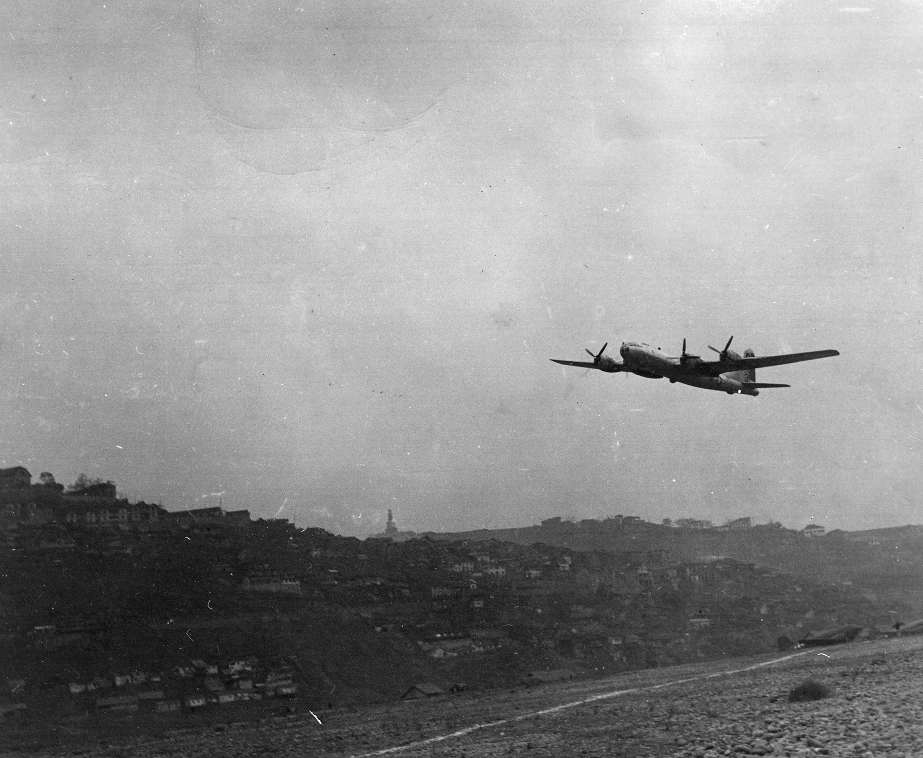
Due to the narrower wing and increased weight, the B-29 needed a longer runway to help generate the lift needed for take-off.
Fowler Flaps increased the wing area to create the extra lift required.

Slide 13
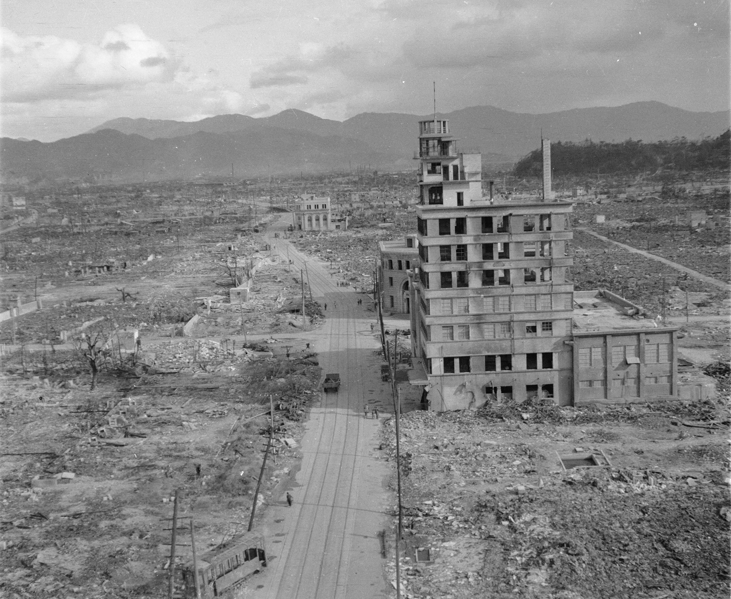
Legacy
The B-29 was the only aircraft capable of dropping an atomic bomb from such a height and be able to get away safely.
Two B-29s carried the atomic bombs which were dropped on Hiroshima and Nagasaki in August 1945, killing thousands and leaving long lasting effects of radiation.

Slide 14
War in the Air: What has Changed?
Bombsights
Although the use of aircraft in combat wasn’t a new concept in World War II, the development of the bombsight helped to make them a strategic weapon.
Bombsight technology allowed for more accurate bombing runs and precision targeting of military and industrial locations.
By factoring in altitude, air speed, and ground speed, World War II bombsights allowed bombers to fly at higher altitudes during their bombing missions which provided safety to the bombers and their crews from anti-aircraft guns and defending fighter aircraft.

Slide 15
When a bomb is dropped from an airplane it does not fall straight down but actually moves forward as it falls. This is caused by the horizontal movement of the plane in flight .
A falling bomb is also affected by the air resistance created by falling through the air, which causes the bomb to always be behind the plane when it strikes the target.
The aircraft must be flying in a vertical plane passing through the target at the time of bomb release and also flying on an even keel. Bombing during World War II was virtually always done when flying either up or down wind.

Slide 16
Pre-WWII Bombing
Before the invention of mechanical bombsights, bombing was done manually with the bombardier physically dropping a bomb with his hands.
This type of bombing was obviously very indiscriminate and produced more of a psychological effect on the enemy than a physical one.

Slide 17
Accurate high altitude bombing was relatively impossible before the development of bombsights.
To bomb accurately, planes had to fly at lower altitudes, placing themselves within the range of anti-aircraft guns.
Britain overcame this issue by flying their bombing runs at night. This created another issue though, indiscriminate bombing.

Slide 18
It can be argued over whether the military commands even cared about precision bombing as a strategy to win the war!
Prime Minister Winston Churchill ordered in 1940
  “an absolutely devastating, exterminating attack by very heavy bombers upon the Nazi homeland.”
Air Vice Marshall Harris added to this by stating
  “We shall destroy Germany’s will to fight…render 25 million Germans homeless, kill 900,000…”.
Adolph Hitler stated that same year
  “We will raze their cities to the ground….”

Slide 19
When Canada declared war on September 10, 1939, Canada had:
  210 Aircrafts, only 36 which were modern
  5 000 permanent Air Force personnel
By 1945, Canada’s Air Force grew to:
    The 4th largest air force in the world
    164 000 personnel (16 000 women)
Participated in raids over Nazi-occupied Europe
    saturation bombing: using a very large number of bombs on one target
  Main target: Industrialized cities with giant Krupp armaments factories

Slide 20
“I realized in that moment just how lucky a fighter pilot is. He has none of the personalized feelings of the soldier, handed a rifle and bayonet and told to charge… the fighter pilots emotions are those of the duelist- cool, precise, impersonal.”
Richard Hillary, RAF

Slide 21
The life expectancy of fighter pilots was measured in weeks, the typical airman had less than 4 to 1 odds of surviving the war unscathed
For every Canadian who flew, 15 more were needed to service aircrafts on the ground
What would you argue are the Pros and Cons of joining the RCAF over the Army or the Navy?

Slide 22
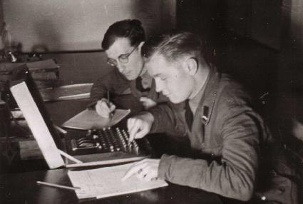
War on Land: What has Changed?
The Enigma Machine & Code Breakers
The Enigma machine was a piece of hardware invented by a German and used by Britain's codebreakers as a way of deciphering German signals traffic during World War Two.
It has been claimed that as a result of the information gained through this device, hostilities between Germany and the Allied forces were curtailed by two years.
Video: Code Breakers of Bletchley Park
Video: Enigma Code

Slide 23
War on Land: What has Changed?
Semi-Automatic Weapons: The M-1 Garand Rifle
The M-1 Garand Rifle (American) was called the “greatest battle implement ever devised” by General George Patton. Its accuracy, volume of fire, and reliability were exceptional.
The Germans and Japanese tended to use bolt-action rifles, which meant that soldiers had to load a new round of ammunition manually before they could fire the weapon again. The M-1 was semi-automatic, meaning that soldiers could fire round after round by simply squeezing the trigger.
  Trained soldiers could deliver 8 aimed rounds in 20 seconds!

Slide 24
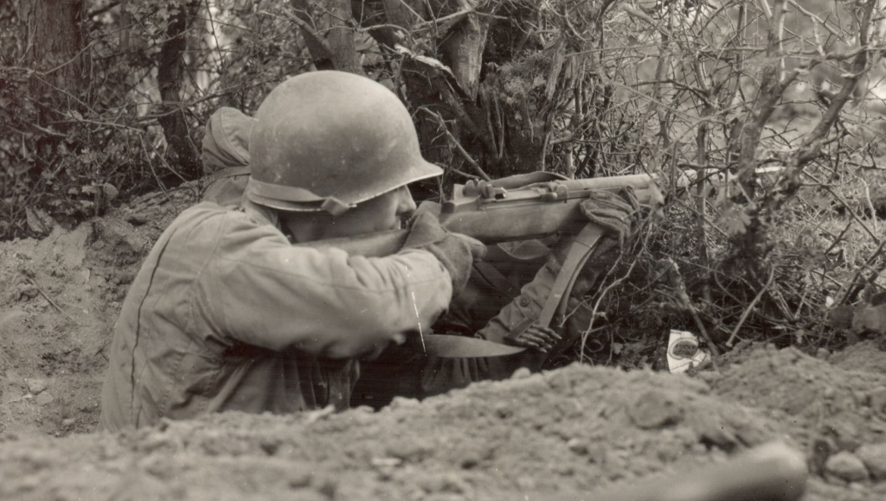

Slide 25
War on Land: What has Changed?
Semi-Automatic Weapons: The 88mm Gun
The most famous artillery piece of war was the German 88mm gun, also known as the 88.
Originally designed as an anti-aircraft gun, the 88 was quite effective in that role.
  In 1941, the British lost more than 40 tanks to the 88s used as anti-tank guns.
Although British, Soviet, and American weapon designers tried to match the capabilities of the 88 they never could.
The 88 ruled the armoured battlefield of World War II.

Slide 26
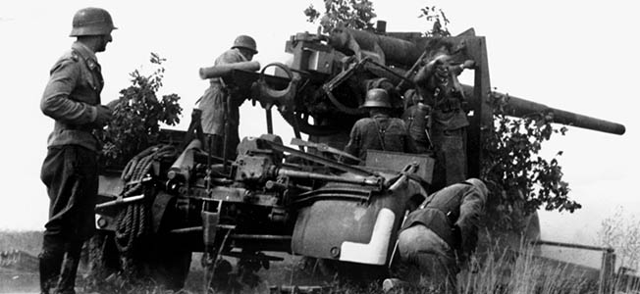
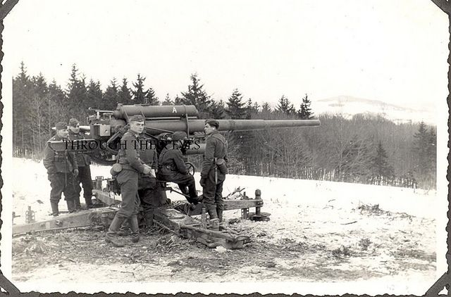
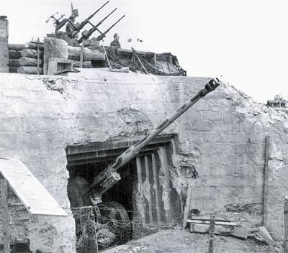

Slide 27
War on Land: What has Changed?
Tanks: The German Tiger Tank
The Tiger Tank had the best combination of protection and firepower of any tank in WWII:
  Massive armour on the hull and on the turret
  An 88mm main gun
  Wide treads for cross-country travel
  The capability to cross through water up to 16 feet deep
The engine though was underpowered, and it was not as effective as expected in moving over muddy or snow-covered ground, like in Russia.
It was also unsuccessful in Italy because of the hilly terrain and lack of bridges strong enough to hold it.
In Normandy, and in the battlefields in France and Germany, the Tiger performed at its best.

Slide 28
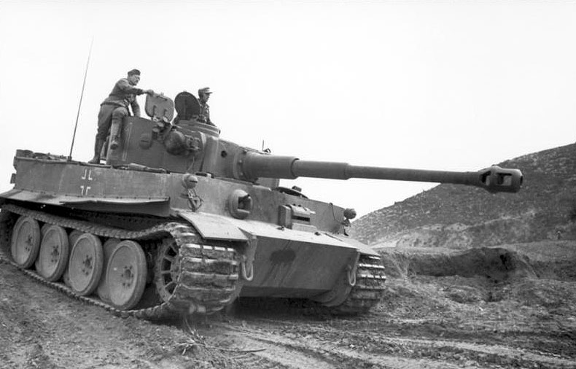

Slide 29
War on Land: What has Changed?
Tanks: The Soviet T34 Tank
The T34 was the best all-purpose fighting vehicle of the war.
With its 76mm main gun, and 2 machine guns, the tank was low and wide, designed for the mud and snow of Russia.
Mechanically reliable and well-armoured, the tank had a top speed of 30mph and could travel 180 miles before refueling.

Slide 30
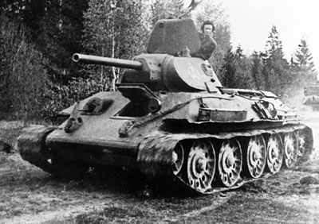

Slide 31
War on Land: What has Changed?
Tanks: The Sherman Tank
The Sherman tank was the most commonly used American tank in World War II. More than 50,000 Shermans were produced between 1942 and 1945.
The model proved itself somewhat effective against German Mk II and Mk IV Panzers, but it was thoroughly outclassed by the Tiger, Panther and King Tiger tanks.
Notorious for their flammability, Shermans were nicknamed “Ronsons” after a lighter with the slogan “lights every time.”
Notes:
Research for tank casualties in Normandy from 6 June to 10 July 1944 conducted by the British No. 2 Operational Research concluded, that from a sample of 40 Sherman tanks, 33 tanks burned up (82%) and 7 tanks remained unburned following an average of 1.89 penetrations. In comparison, from a sample of 5 Panzer IV's, 4 tanks burned up (80%) and 1 tank remained unburned, following an average of 1.5 penetrations.

Slide 32
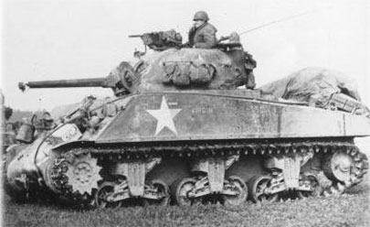
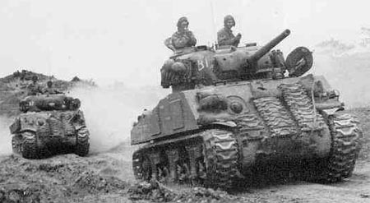

Slide 33
War on Land: What has Changed?
The Atomic Bomb
Begun as a scientific theory of trying to split atoms to produce energy in the 1930s, Albert Einstein tried to enlist President Roosevelt’s help to get funding to conduct experiments to test if a weapon could be made using such a concept.
By 1941, Roosevelt began to listen…
In 1945, the concept became reality.
By purposefully creating a rapid chain reaction of sub-atomic particles, these substances could explode and release energy in unimaginable amounts.
A weapon of enormous power, the atomic bomb ended WWII in a way that no other weapon could have.

Slide 34


Slide 35
When the mystery of the atom was unlocked, the world had to deal with the consequences, both good and bad.
Knowledge of the atom’s power, and advancing technology, created many benefits of humankind in energy and medicine, but it also led to vast arsenals of nuclear weapons that contained the power to destroy the world.
Today, we still debate the role of atomic power, and we are still threatened by those who would use it to threaten the peace of the world.

Slide 36
War in the Sea: What has Changed?
The Merchant Marine
Wartime was often a time of great danger, but the danger was not faced only by those in military uniform.
Those who served in the Merchant Navy, a fleet of transport ships that carried desperately needed equipment, fuel, goods and personnel to Europe and around the world, had to do their vital job knowing that their ships were prime targets for enemy action.
From the very beginning of the war, German submarines tried to cut supply routes across the Atlantic, threatening the transportation of vital goods and personnel to Britain.
Along with the RCN and the RCAF, the Merchant Navy played a key role in the six-year campaign to clear the Atlantic of U-boats.
  It was far from easy - they faced fierce attacks by German submarines and hazardous, life-threatening weather conditions in the North Atlantic - but they put themselves in harms way in the quest for peace and freedom in the world.

Slide 37
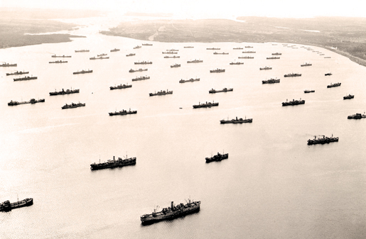

Slide 38
War in the Sea: What has Changed?
The Corvette
A small ship, was an easily and cheaply built patrol and convoy escort vessel.
62.5m long and 10 m wide
Could maintain roughly the same speed as a surfaced U-Boat.

Slide 40
War in the Sea: What has Changed?
Aircraft Carriers
Many of World War II’s greatest battles were fought at sea, making naval technologies crucial to all sides.
  Many kinds of ships, such as battleships, submarines, and aircraft carriers, had been used in previous wars, but the global nature of World War II made naval battles especially important.
An aircraft carrier is a ship whose primary purpose is to bring airplanes closer to distant battle areas.
  Since most World War II aircraft had a range of just a few hundred miles, it was necessary to bring the aircraft to the battlefront, and using a ship to do so made a lot of sense in the Pacific where much of the fighting took place on islands and coastal areas.

Slide 41
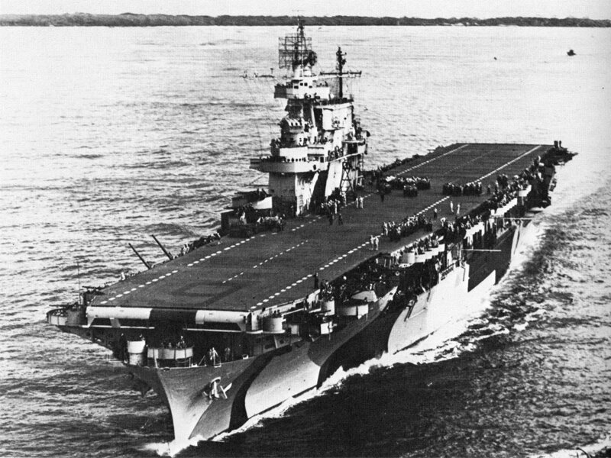
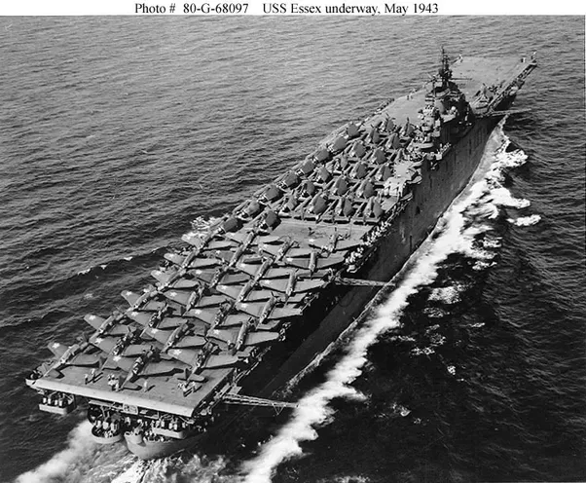

Slide 42
War in the Sea: What has Changed?
U-Boats
German U-Boats were a fearsome adversary of the Allies. Hunting in wolfpacks, these subs stalked Allied convoys, picking off the most vulnerable targets and pursuing the ships until they made port.
The airplane became the U-boat’s greatest enemy. The Allies eventually build aircraft capable of flying longer distances and with better technology, such as radar, to help them protect the ships.
As soon as a sub raised its periscope or fired a torpedo, it could almost always expect an air attack.
The Germans would end up losing nearly 700 U-boats (80% of their fleet)

Slide 43
