Slide 1
Major Battles of WWI

Slide 3
The total number of military and civilian casualties in WWI was more than 37 million.
There was over 16 million deaths and 20 million wounded.

Slide 4
Battle of Tannenberg
August 26-30, 1914
Prior to the start of World War I, Russia boasted one of the largest militaries in the world.
  In 1914, their army consisted of nearly six million conscripts, all of whom were victims of the growing sense of militarism and paranoia sweeping Europe in the years before the war.
  Despite the tactical advantage of size, the Russian Imperial Army was poorly trained and ill-equipped for a modern war. Still, the Germans feared nothing more than a war with Russia and its seemingly inexhaustible supply of men.

Slide 5
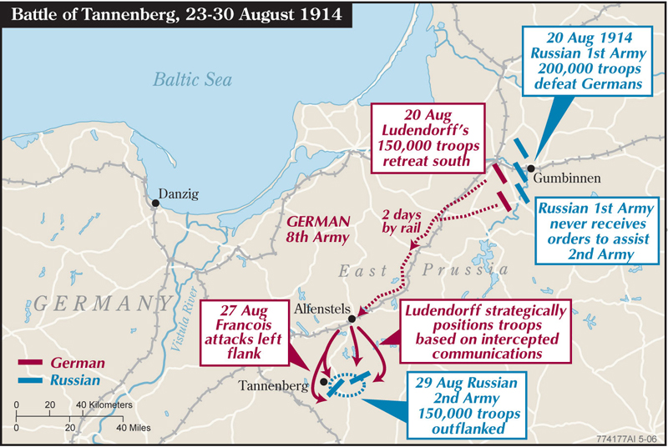

Slide 6
Following the Schlieffen plan, German leaders sent the majority of their army into Belgium and France.
One army, the Eighth, was sent to defend Germany’s Eastern border.
Two weeks after the war began, Russia kept its promise to France and invaded Germany despite their lack of preparedness.

Slide 7
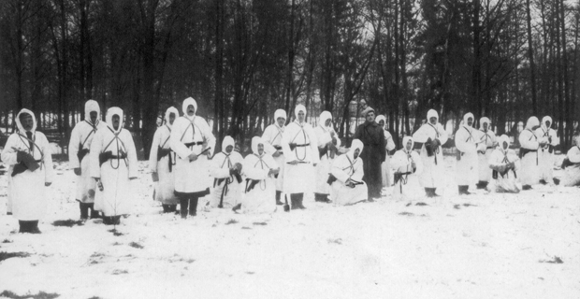
Russian soldiers in winter uniform

Slide 8
Despite being outnumbered by two Russian field armies, the Germans managed to inflict a huge defeat on the Russians at Tannenberg, decimating the second army, and annihilating the majority of the first army.
This was one of the first major battles of WWI. It was a resounding victory for the German army and proved that they could defeat larger armies through superior tactics and training.

Slide 9
Casualties
Russia: 170,000
Germany:12,000
Total: 182,000

Slide 10
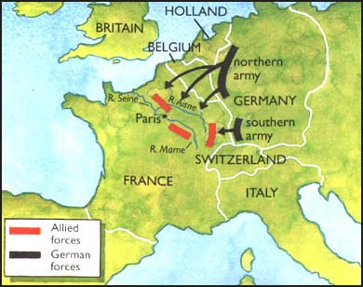
The Battle of Marne:
September 4-10, 1914
The German army crossed the Belgian border on August 3rd 1914. The Britain and France declared war on Germany on August 4th.
At the start of the First World War, Germany hoped to avoid fighting on two fronts by knocking out France before turning to Russia, France’s ally.
The initial German offensive had some early success, but there were not enough reinforcements immediately available to sustain momentum.
The French and British launched a counter-offensive at the Marne and after several days of bitter fighting the Germans retreated.

Slide 11
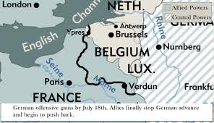

Slide 12
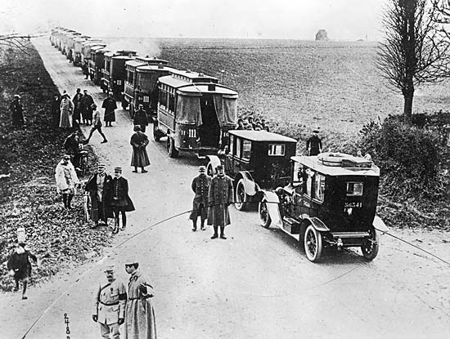
Taxis of the Marne
Notes:
The French used taxis in Paris to help move troops quickly around the battlefield. These taxis became a symbol of France’s will to win the war.

Slide 13
Germany’s failure to defeat the French and the British at the Marne also had important strategic implications.
The Russians had mobilised more quickly than the Germans had anticipated and launched their first offensive within two weeks of the war’s outbreak.
The Battle of Tannenberg in August 1914 ended in German victory, but the combination of German victory in the east and defeat in the west meant the war would not be quick, but protracted and extended across several fronts.

Slide 14
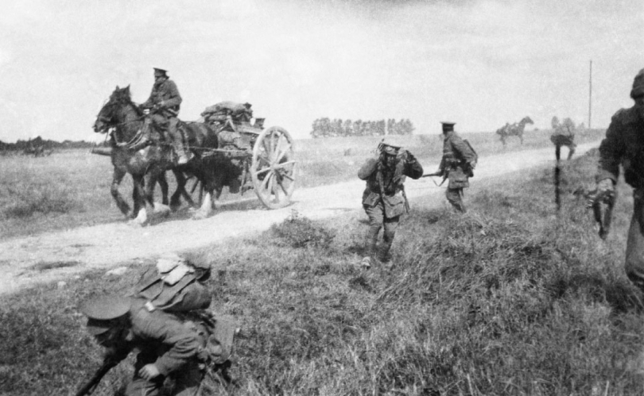

Slide 15
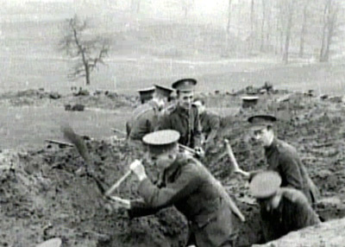
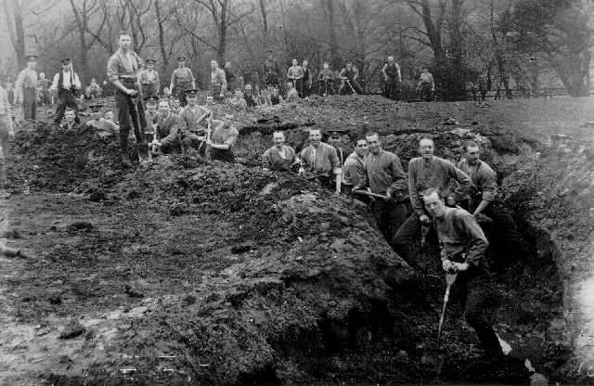
The Battle of the Marne also marked the end of mobile warfare on the Western Front.
Following their retreat, the Germans re-engaged Allied forces on the Aisne, where fighting began to stagnate into trench warfare.

Slide 16
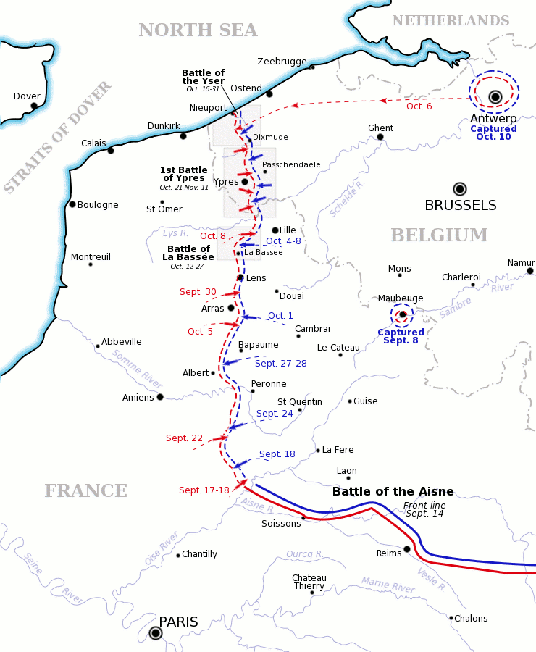
Allied trenches
German trenches

Slide 17
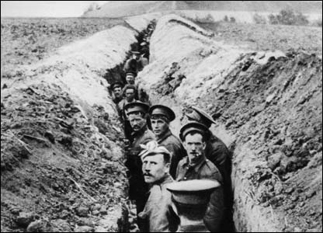
The Race to the Sea
The Battle of the Marne was a turning point. The Schlieffen Plan had failed. Germany was now caught up in a war on two-fronts.
The German generals realised they could not break through the enemy lines. Moltke was replaced as commander by Falkenhayn who decided to try and outflank the enemy.
By the end of 1914, fighting had reached a stalemate. The German army decided to hold ground by digging trenches.
The Battle of the Marne proved the Schlieffen Plan to be a failure, as it showed that Germany’s idea of a fast victory would not happen.

Slide 18
Casualties
Allies: 263,000
Germany: 220,000
Total: 483,000

Slide 19
Gallipoli
April 25, 1915-January 9, 1916
The Gallipoli campaign was the land-based element of a strategy intended to allow Allied ships to pass through the Dardanelles, capture Constantinople (now Istanbul) and ultimately knock Ottoman Turkey out of the war.
  But Allied plans were based on the mistaken belief that the Ottomans could be easily overcome.

Slide 20
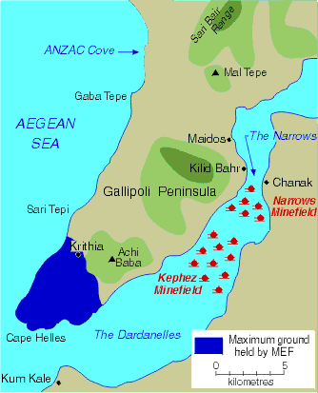
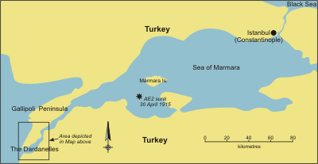

Slide 21
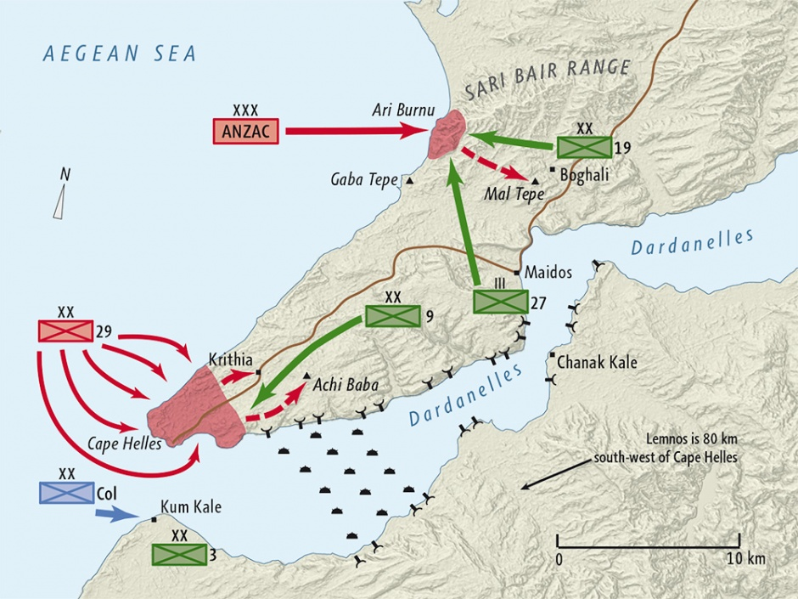

Slide 22
At dawn on 25 April 1915, Allied troops landed on the Gallipoli peninsula in Ottoman Turkey.
General Sir Ian Hamilton decided to make two landings, placing the British 29th Division at Cape Helles and the Australian and New Zealand Army Corps (ANZAC) north of Gaba Tepe in an area later dubbed Anzac Cove.
  Both landings were quickly contained by determined Ottoman troops and neither the British nor the Anzacs were able to advance.

Slide 23
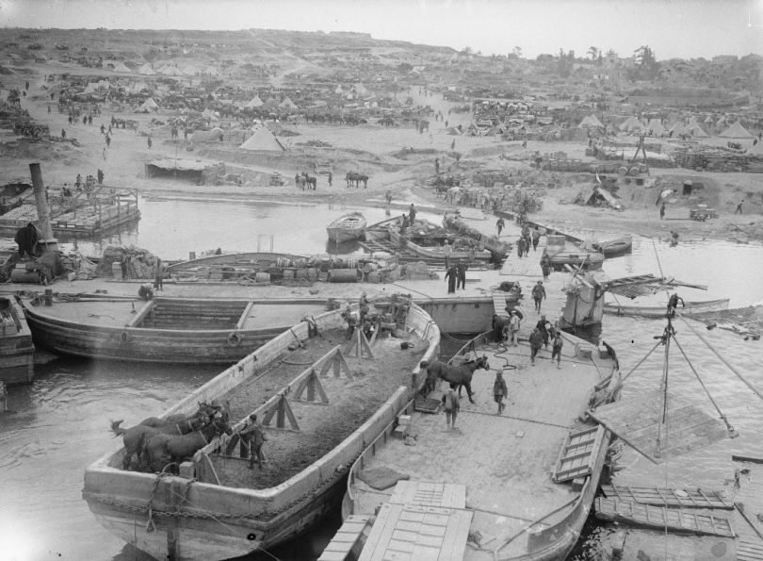

Slide 24
Trench warfare quickly took hold, mirroring the fighting of the Western Front.
Casualties mounted heavily and in the summer heat conditions rapidly deteriorated.
  Sickness was rampant, food quickly became inedible and there were vast swarms of black corpse flies.
In August a new assault was launched north of Anzac Cove. This attack, along with a fresh landing at Suvla Bay, quickly failed and stalemate returned.

Slide 25
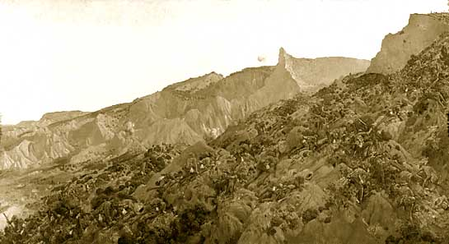
The ANZAC Landing

Slide 26
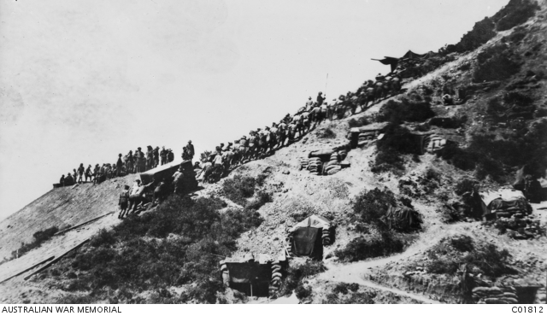
New Zealand Soldiers dragging a water tank up the hill from Anzac Cove.

Slide 27
In December, it was decided to evacuate – first Anzac and Suvla, and then Helles in January 1916.
Gallipoli became a defining moment in the history of both Australia and New Zealand, revealing characteristics that both countries have used to define their soldiers: endurance, determination, initiative and 'mateship'.
For the Ottomans, it was a brief respite in the decline of their empire. But through the emergence of Mustafa Kemal (later known as Atatürk) as one of the campaign's leading figures, it also led to the foundation of modern Turkey.

Slide 28
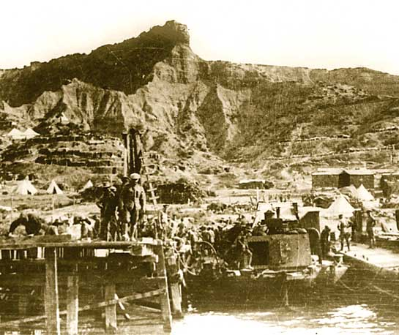
Evacuation
Williams Pier, North Beach, Gallipoli, December 1915

Slide 29
Casualties
Allies: 220,000
Turkey: 253,000
Total: 473,000

Slide 30
Battle of Verdun
February 21-December 18, 1916
The Battle of Verdun was the longest battle of the First World War. It was also one of the costliest.
It began in February 1916 with a German attack on the fortified French town of Verdun, where bitter fighting would continue for most of the year.

Slide 31
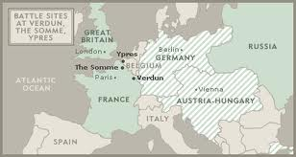

Slide 32
The ten-hour opening bombardment saw an unprecedented concentration of firepower and although the French were forced back they did not break.
In the summer, the Germans were forced to reduce their strength at Verdun after the British and Russians launched their own offensives elsewhere.

Slide 33
The French retook lost ground in the autumn and through careful management of their army, efficient logistics and the resilience of the troops fighting for their homeland, the French secured a defensive victory before the year’s end.
The Germans had lost over 430,000 men killed or wounded and the French approximately 550,000. The trauma of this loss not only affected French political and military decision-making during and after the war, it had a lasting effect on French national consciousness.

Slide 34
Verdun also had serious strategic implications for the rest of the war.
The Allies had planned to defeat Germany through a series of large co-ordinated offensives, but the German attack at Verdun drastically reduced the number of French troops available.

Slide 35
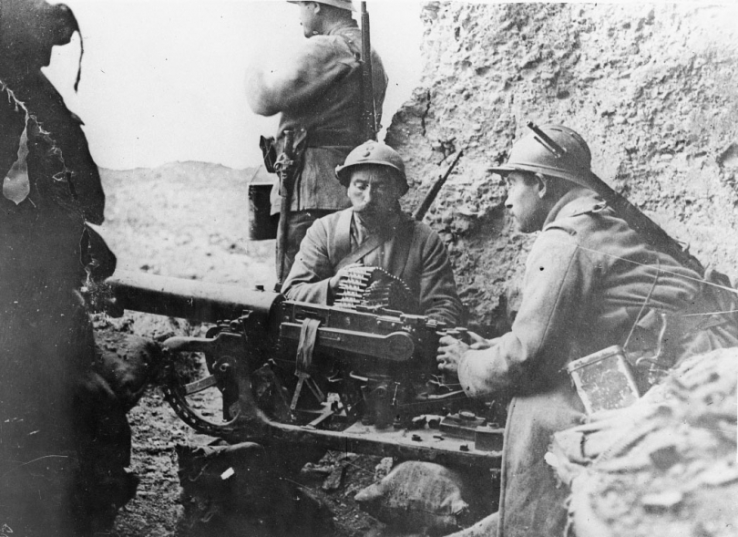

Slide 36
Nearly 40 million artillery shells were exchanged during the battle, marking the are with craters which are still visible to this day.

Slide 37
Casualties
Allies: 542,000 (mostly French)
Germany: 435,000
Total: 976,000

Slide 38
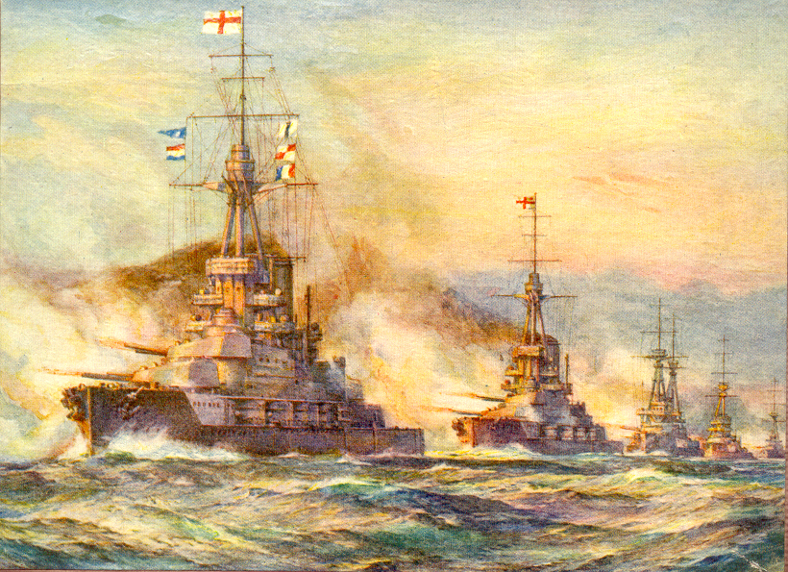
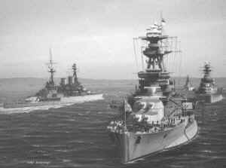
The Battle of Jutland
May 31-June 1, 1916
The Germans sought to break the British blockade by destroying a portion of the Royal Navy. The Germans had the best exchanges but the British fleet was simply too large.
This was the largest naval battle of WWI.
It was the only time that the British and German fleets of 'dreadnought' battleships actually came to blows.

Slide 39
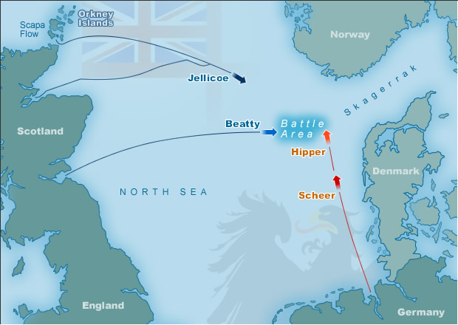

Slide 40
The German High Seas Fleet hoped to weaken the Royal Navy by launching an ambush on the British Grand Fleet in the North Sea.
German Admiral Reinhard Scheer planned to lure out both Admiral Sir David Beatty’s Battlecruiser Force and Admiral Sir John Jellicoe's Grand Fleet.
Scheer hoped to destroy Beatty’s force before Jellicoe’s arrived, but the British were warned by their codebreakers and put both forces to sea early.

Slide 41
Jutland was a confused and bloody action involving 250 ships and around 100,000 men.
The British lost 14 ships and over 6,000 men, but were ready for action again the next day.
The Germans, who had lost 11 ships and over 2,500 men, avoided complete destruction but never again seriously challenged British control of the North Sea.

Slide 42
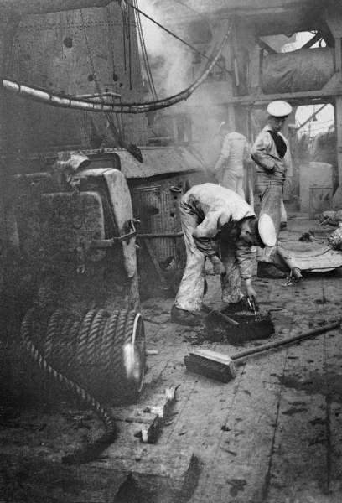

Slide 43
Results of the battle
Both sides claimed victory, so who won the battle?
The British War | The German War
The Germans had fled the battle. The German fleet rarely went to sea again, leaving the Royal Navy in control of the North Sea. The British continued to blockade Germany. A US newspaper summarised the outcome of Jutland in this way: ‘The German fleet has assaulted its jailor, but it is still in jail.’ The Germans were forced to revert to unrestricted U-boat warfare, which brought the USA into the war on the Allied side. | The Germans had inflicted the greater losses, with 14 British and only 11 German ships sunk. The British suffered far heavier casualties – 6000 British to 2500 Germans. German gunnery was far better – about half of all big shells scored hits compared with about 1/3 of those fired by the British ships. The design of the German ships, especially the gun turrets, was shown to be better.

Slide 44
Casualties
Britain: 14 ships sunk, 6094 killed, 674 wounded, 177 captured
Germany: 11 ships sunk, 2551 killed, 507 wounded
Result: Germans claim victory but too weak to ever attempt a full naval attack and retreat to ports.

Slide 45
The Battle of the Somme
July 1-November 18, 1916
While Germans were busy fighting the French at Verdun, the Allies tried to end trench warfare with a huge attack on the German trenches at The Battle of Somme
The attack was not successful. It is considered to be the BIGGEST disaster in British history: 58,000 casualties in one day.

Slide 47
The Germans were not pushed back
Over 20,000 Canadians were killed
90% of the Newfoundland regiment was killed
After 5 months of fighting, the Allies had only gained a few kilometres of territory

Slide 48
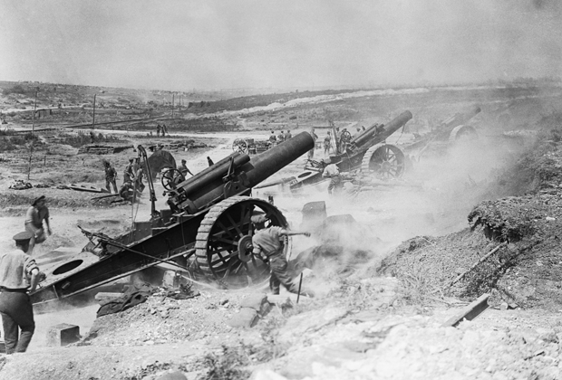

Slide 49
The Battle of Somme was a disaster for many reasons
The Allies shells were too weak to damage German concrete bunkers buried deep underground
Allied troops were overloaded with 25 – 60 kgs of gear
A nearby mine was detonated ten minutes before the attack, which warned the Germans
The attack was delayed and happened in daylight, rather than at night
The attack was ordered to continue, even though most soldiers were dying

Slide 50
“We are so busy here that we scarcely know where to turn. It is just a procession of wounded coming and going all the time, for we have to send them off as quickly as possible in order to make room for the new arrivals. Thirty-eight went off last Tuesday and fifteen on Friday, but the beds are filled up again. The last ones we have been getting are so badly wounded that I wonder who can be moved on Tuesday.”
-Agnes Warner, Canadian nurse at the Somme, in a letter home, 1916

Slide 51
General Douglas Haig was in charge of this offensive. He used an old war tactic of marching soldiers into battle
As more and more troops were ordered to march across open fields they were shot down by German machine guns.

Slide 52
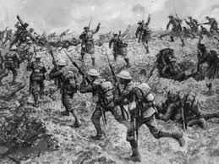
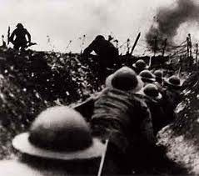

Slide 53
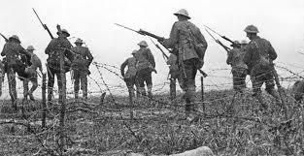

Slide 54
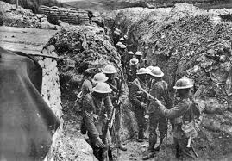

Slide 55
The 90% of Royal Newfoundland Regiment (over 700 men) were killed within 3o minutes of fighting.
Armoured tanks were first used in the battlefields of Somme
British Commander Haig claimed victory, but little was gained

Slide 56
Battle of Verdun and the Battle of Somme were the two battles that had the greatest impact on the war.
Both Somme and Verdun were planned wars of attrition (an attacking strategy that wears down an enemy with constant attacks)
Verdun was to the French and Germans what the Somme was to the British: a symbol of the horrors of war, and the futility of WWI

Slide 57
Casualties
Allies: 623,906
  Including 19,240 in one day: the greatest single day loss of life in the history of the British Army
  100 tanks, 782 aircraft
Germany: 600,000
Total: 1,219,201

Slide 58
Hundred Days offensive
August 8-November 11, 1918
The Battle of Amiens (8-11 August 1918) heralded the start of the Hundred Days campaign, a four-month period of Allied success.
After surviving the German Spring Offensives, Allied forces launched a counter-punch of their own and from the summer of 1918 onwards, they were constantly on the advance.

Slide 59
Casualties
Allies:1,069,636 (including 127,000 Americans)
Germany: 785,733
Total: 1,855,369

